Slide 1
CEO Report to the Annual General Meeting
Mark Wilson
December 2020

Slide 2
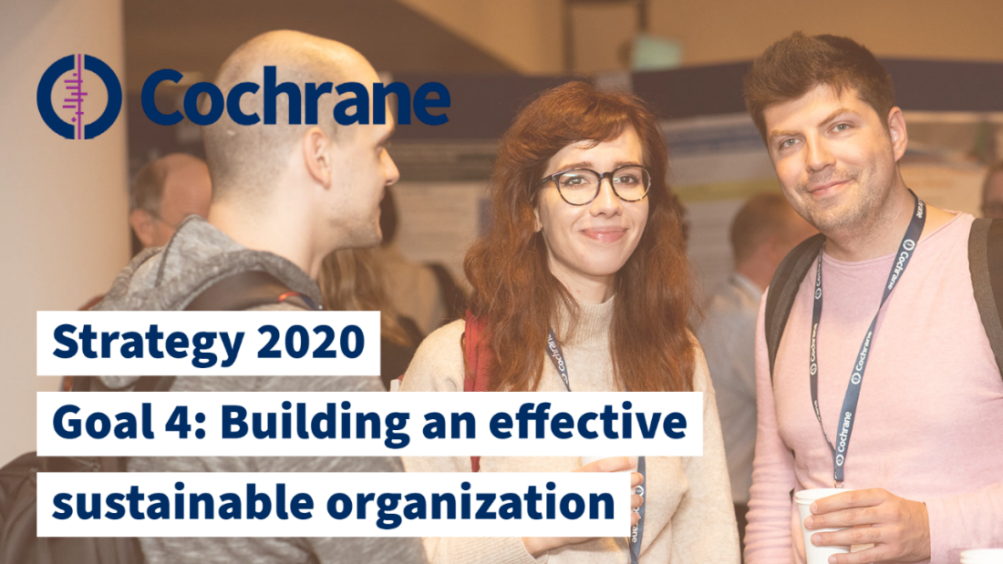
Strategy to 2020: A transformational Strategy delivered …
Notes:
Continuity
Delivering existing priorities to greater depth
Nothing new here, all of this is critical work to deliver our mission

Slide 3
Strategy to 2020: A transformational Strategy delivered …
Goal 1: To produce high-quality, relevant, up to date systematic reviews and other research evidence …
Metric | 2013 | 2020
Total Cochrane Reviews in CDSR | 10,355 | 13,701
Total CENTRAL records | 715,122 | 1,715,798
Median time (protocol to review - months) | 29 | 22.9
Summary of Findings Tables | 44% | > 92%
Cochrane Library Impact Factor | 5.939 | 7.890 (2019)
Notes:
Continuity
Delivering existing priorities to greater depth
Nothing new here, all of this is critical work to deliver our mission

Slide 4
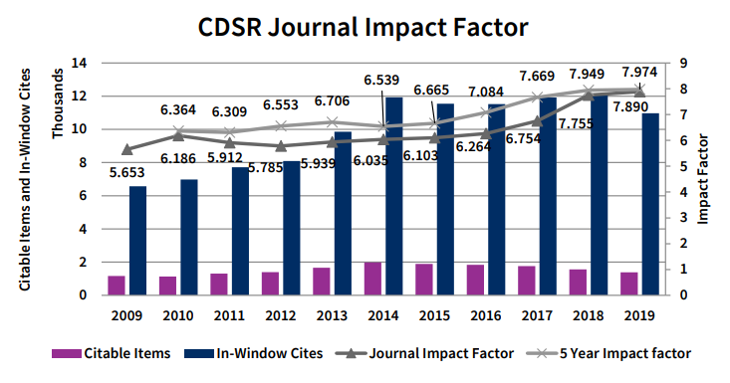
Strategy to 2020: A transformational Strategy delivered …
Notes:
Continuity
Delivering existing priorities to greater depth
Nothing new here, all of this is critical work to deliver our mission

Slide 5
Strategy to 2020: A transformational Strategy delivered …
In 2020:
Outstanding Cochrane response to the COVID-19 pandemic
Experience gained informed further devpt of Cochrane’s editorial & production systems
Implementation of Editorial and Management System begun, with roll out planned for 2021
New COI policy published and took affect on 14 October
Notes:
Continuity
Delivering existing priorities to greater depth
Nothing new here, all of this is critical work to deliver our mission

Slide 6
Strategy to 2020: A transformational Strategy delivered …
Goal 2: To make Cochrane evidence accessible and useful to everybody, everywhere in the world.
Record levels of Users of Cochrane evidence around the world!
Built the foundations of a true knowledge translation-oriented organization
Made our evidence open and accessible to billions more people through translations and our Open Access policy
Notes:
Continuity
Delivering existing priorities to greater depth
Nothing new here, all of this is critical work to deliver our mission

Slide 7
Cochrane.org Visits (to Dec 10)
Notes:
It’s working: millions more people are using our evidence … Cochrane.org
80 million page views from 53.5 million users.
3.66 billion people worldwide have free ‘one click’ at the point of use access

Slide 8
Strategy to 2020: A transformational Strategy delivered …
Goal 2: To make Cochrane evidence accessible and useful to everybody, everywhere in the world.
Metric | 2013 | 2020
Cochrane.org visits per year | 4 million | 80 million
Cochrane Library pdf downloads per year | 6.1 million | 11.9 million
Number of Reviews available Open Access | 0% | 70%
Number of translated Abstracts & PLS | 11,500 (5) | 34,000 (12)
Accessed content in non-English browsers | 6% | 83%
Notes:
Continuity
Delivering existing priorities to greater depth
Nothing new here, all of this is critical work to deliver our mission

Slide 9
Strategy to 2020: A transformational Strategy delivered …
In 2020:
Plain-Language Summaries pilot successfully started
Knowledge Translation ‘Dissemination Checklist’ published; Leaning module launched; KT mentorship scheme successfully piloted
Significant additional resources to support multilingual translations of evidence & KT outreach
COVID-19 ‘snapshot’ evaluation of work so far conducted
Open Access consultation postponed until 2021
Notes:
Continuity
Delivering existing priorities to greater depth
Nothing new here, all of this is critical work to deliver our mission

Slide 10
Strategy to 2020: A transformational Strategy delivered …
Goal 3: To make Cochrane the ‘home of evidence’ to inform health decision making
New Cochrane branding launched in 2015
Delivered an enhanced Cochrane Library platform
Significantly higher profile globally
Highly successful partnerships with WHO, Wikipedia & others
Global Evidence Summit (GES) as premier ‘evidence event’ launched with partners (G-I-N, Campbell, JBI)
Stronger advocacy & representational profile on relevant issues (AllTrials, REWARD prize, WHO Assemblies)
Notes:
Continuity
Delivering existing priorities to greater depth
Nothing new here, all of this is critical work to deliver our mission

Slide 11
Notes:
An extraordinary year - again.
Meeting the challenges of:
A global pandemic - COVID 19
Progressing the transformational levels of change of the Strategy 2020 . . . and looking to the Strategy 2021 - 2025
Keeping the lights on whilst the world is shifting on its axis
Please reference the COVID evaluation and that the SMT has received a report, is considering it, will provide a response along with the report early next year

Slide 12
Strategy to 2020: A transformational Strategy delivered …
Goal 4: To be a diverse, inclusive and transparent organization that effectively harnesses the enthusiasm and skills of our contributors, guided by our principles, governed accountability, managed efficiently and makes optimal use of our resources.
Opening Cochrane up globally for new members and supporters; and transforming how we support and develop them
Notes:
Continuity
Delivering existing priorities to greater depth
Nothing new here, all of this is critical work to deliver our mission

Slide 13
Priscila Verduzco, Mexico – Cochrane’s 100,000th registered member or supporter!
100,000 members and supporters
Notes:
17% growth in 9 months to end of Sept
We have clarity on our membership and are GDPR compliant
Broader range of contributions being used to offer membership
Further integration of TaskExchange for all task based opportunities
Simpler sign up process for patients and members of public * Students

Slide 14
New Join Cochrane pages to allow people to more easily engage with Cochrane!

Slide 15
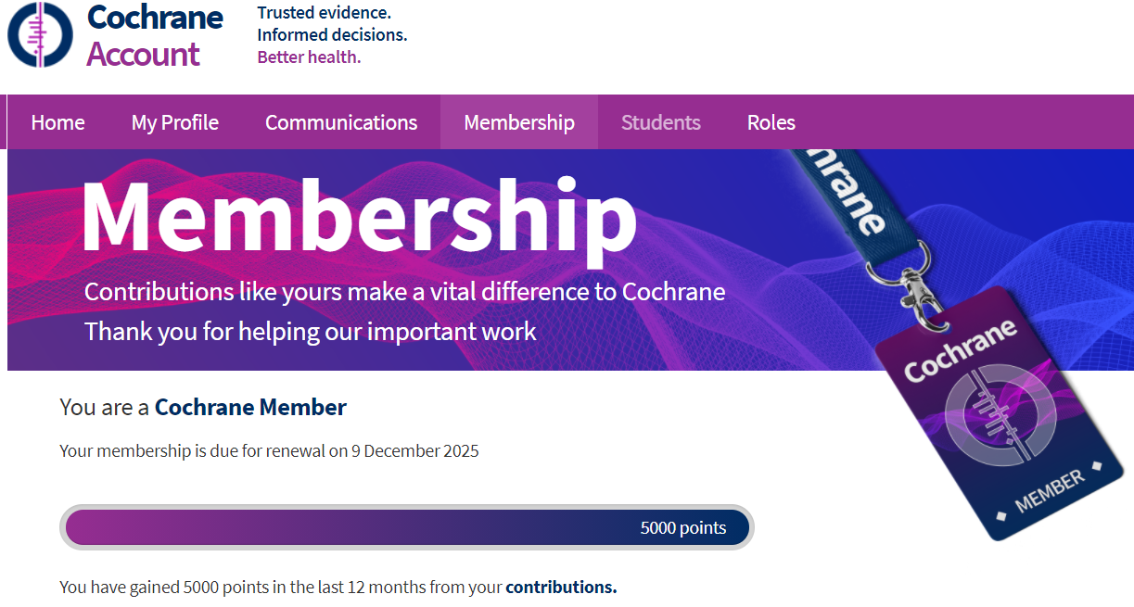
New My Account pages
All can view their contributions and download their membership or supporter badge and certificate
Allow supporters to easily see their progress to achieving Cochrane membership

Slide 16
Strategy to 2020: A transformational Strategy delivered …
Goal 4: To be a diverse, inclusive and transparent organization that effectively harnesses the enthusiasm and skills of our contributors, guided by our principles, governed accountability, managed efficiently and makes optimal use of our resources.
Opening Cochrane up globally for new members and supporters; and transforming how we support and develop them
Cochrane Group’s global expansion and diversity continues
Notes:
Continuity
Delivering existing priorities to greater depth
Nothing new here, all of this is critical work to deliver our mission

Slide 17
New Geographic Affiliates
New Cochrane China Network
Geographic Groups that expanded with new Affiliates in 2020
Associate Centres upgraded to full Centres
1 new affiliate
2 new affiliates
4 new affiliates
4 new affiliates
Notes:
Nov 2020: 100 geographic groups, 22 centres, 42 associate centres and 36 affiliates
2014: 34 geographic groups, 17 centres, 14 associate centres and 2 affiliates

Slide 18
Strategy to 2020: A transformational Strategy delivered …
Goal 4: To be a diverse, inclusive and transparent organization that effectively harnesses the enthusiasm and skills of our contributors, guided by our principles, governed accountability, managed efficiently and makes optimal use of our resources.
Opening Cochrane up globally for new members and supporters; and transforming how we support and develop them
Cochrane Group’s global expansion and diversity continues
New publishing contract with Wiley gives Cochrane financial security for the next decade
Notes:
Continuity
Delivering existing priorities to greater depth
Nothing new here, all of this is critical work to deliver our mission

Slide 19
Strategy to 2020: A transformational Strategy delivered …
Goal 4: To be a diverse, inclusive and transparent organization that effectively harnesses the enthusiasm and skills of our contributors, guided by our principles, governed accountability, managed efficiently and makes optimal use of our resources.
Metric | 2013 | 2020
Cochrane community | 31,800 | 100,000
Cochrane Geographic Groups | 32 | 100
Total Income | £4 million | £9.1 million
Cochrane’s financial Reserves | £3 million | £10.3 million
Notes:
Continuity
Delivering existing priorities to greater depth
Nothing new here, all of this is critical work to deliver our mission

Slide 20
2021 onwards

Slide 21
Drafting together our next ‘Strategic Framework’
Draft ‘Strategic Framework’ posted for consultation with the Community in August
Hundreds of responses received across a variety of channels – thank you for your feedback!
Currently considering all feedback; new draft to come in early 2021

Slide 22
Cochrane’s next decade …
The new strategic framework maintains Strategy to 2020’s themes, but 3-5 year objectives and associated activities will flex and change over time
We will deepen and extend the organizational transformation of Cochrane already achieved
Investments in people, process & technology to ensure we’re future proofed – but greater concentration on effective facilitation and working to maximize value for money
The concentration on responding to user needs, accessibility of our evidence & IMPACT on health decision-making will continue even more

Slide 23
Priorities for 2021-
To continue to improve how Cochrane’s Reviews are produced
Completing implementation of the EMS
Separating the editorial & production functions in CRGs, beginning with a pilot ‘demonstration project’ in 2021
Establishing a Centralised Editorial Service
Developing a much more integrated editorial, technology & product development process for Cochrane – to better unleash the underlying potential of the tools, data & syntheses
Notes:
Continuity
Delivering existing priorities to greater depth
Nothing new here, all of this is critical work to deliver our mission

Slide 24
Priorities for 2021-
To scale up the reach and impact of Cochrane’s Knowledge Translation activities
To invest in initiatives that will promote and deliver long-term financial sustainability for Cochrane
To maintain Cochrane’s high-impact COVID-19 evidence production and translation in health policy and practice
To launch Cochrane’s new ‘Strategic Framework’
To establish a new organizational Monitoring & Evaluation framework
Notes:
Continuity
Delivering existing priorities to greater depth
Nothing new here, all of this is critical work to deliver our mission

Slide 25
… Very tired, but very proud.
Despite the extraordinary pressures and limitations affecting every one of us …
… the restrictions and extra demands affecting our personal lives, professional work, our travel and engagement with others …
Our collaboration has never been more dynamic, more impactful, more recognized.
Despite the uncertainty and fears for the future …
… the Cochrane community has never been so large, so well equipped to grow and thrive in the new world the COVID-19 pandemic will give us.
THANK YOU for all of your efforts

