Slide 1
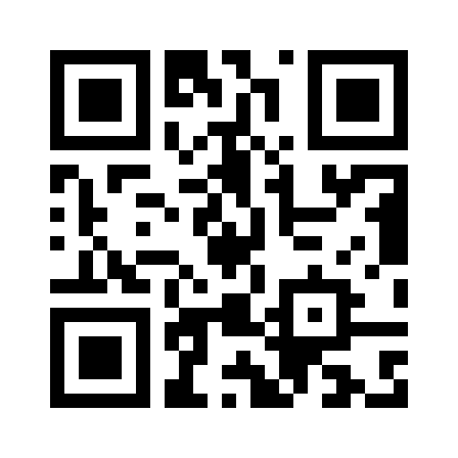
Take your research further with Cochrane’s first open access journal!
Cochrane Evidence Synthesis and Methods welcomes evidence syntheses across health and social care including scoping reviews, rapid reviews, evidence gap maps, brief reports, and methods research. The journal maintains Cochrane’s high standards of integrity and ethics, supported by an expert editorial board.
Reasons to submit your next article:
Save time with quick and easy free format submission.
Open access means more people can read, download, and cite your work.
Make an impact with the leading voice in trusted evidence.
Join the global Cochrane community promoting the value of evidence synthesis and methods.

