Slide 1
CRG Structure & Function
Responses to consultation on options for change

Slide 2
Consultation March 2014
We asked all Cochrane groups. We heard from:
43/53 CRGs 3 Centres & 1 Branch
Methods Exec & 4 MGs Fields Exec & 3 Fields
Consumers Exec 8 individuals
Is change needed?
Responses from web form:
NO 5 CRGs
NEUTRAL 5 CRGs, 3 individuals
YES 26 CRGs, 10 other groups, 5 individuals

Slide 3
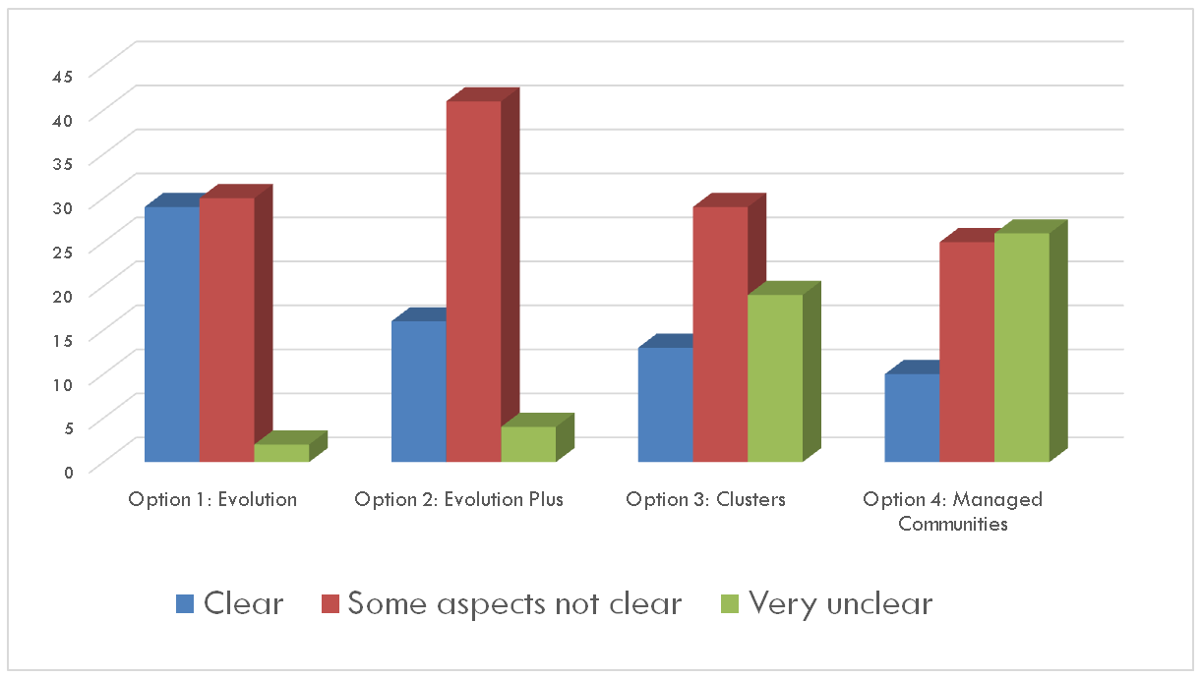
The options
Were they clear?

Slide 4
The options: benefits
Global reach and shared working
Improved author experience

Slide 5
The options: benefits
Improved opportunities for CRG members & other contributors
More efficient editorial process

Slide 6
The options: benefits
Improved quality

Slide 7
The options: harms
Very many risks and harms identified across all options

Slide 8
Preferred option

Slide 9
Unacceptable options

