Slide 1
KT for clinicians
Jeremy grimshaw
Senior scientist and professor
25th oct 2016
jgrimshaw@ohri.ca
@GrimshawJeremy

Slide 2
Background
Consistent evidence of inappropriate care:
  30-40% patients do not get treatments of proven effectiveness
  20–25% patients get care that is not needed or potentially harmful
Suggests that ensuring knowledge translation is a fundamental challenge for healthcare systems wanting to optimise care, outcomes and costs
Schuster, McGlynn, Brook (1998). Milbank Memorial Quarterly
    Grol R (2001). Med Care

Slide 3
KT key concepts
Five key questions
What should be transferred?
To whom should research knowledge be transferred?
By whom should research knowledge be transferred?
How should research knowledge be transferred?
With what effect should research knowledge be transferred?
  Lavis JN, Robertson D, Woodside JN, Mcleod CB, Abelson J (2003) Milbank Quarterly

Slide 4
KT key concepts
What should be transferred?
  Cochrane evidence
To whom should research knowledge be transferred?
  Healthcare professionals (physicians, nurses, physios)
By whom should research knowledge be transferred?
  Cochrane (and partners)
How should research knowledge be transferred?
  $50 million dollar question
With what effect should research knowledge be transferred?
  decisions about health and health care are informed by high-quality, relevant and up-to-date synthesized research evidence
  Lavis JN, Robertson D, Woodside JN, Mcleod CB, Abelson J (2003) Milbank Quarterly

Slide 5
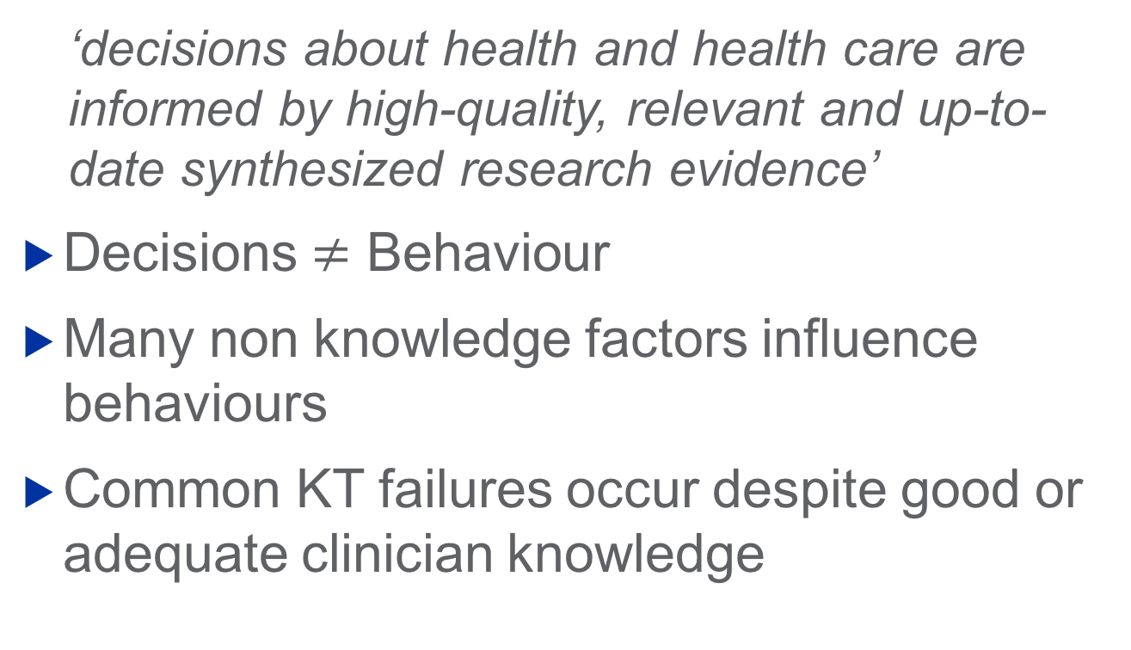
With what effect should research knowledge be transferred?
  ‘decisions about health and health care are informed by high-quality, relevant and up-to-date synthesized research evidence’
Decisions $≠$ Behaviour
Many non knowledge factors influence behaviours
Common KT failures occur despite good or adequate clinician knowledge

Slide 6
Theoretical domains framework
Knowledge
Skills
Social/professional role and identity
Beliefs about capabilities
Beliefs about consequences
Motivation and goals
Memory, attention and decision processes
Environmental context and resources
Social influences
Emotional regulation
Behavioural regulation
Nature of the behaviour
Michie (2005) Quality and Safety in Healthcare

Slide 7
Changing clinician behaviour
Many effective strategies:
  Audit and feedback
  Educational outreach
  Reminders
Cochrane has limited (if any) capacity to deliver these at scale (local healthcare responsibility)
What can/should Cochrane do to promote KT for clinicians?

Slide 8
4 scenarios for KT of cochrane evidence
Within (or around) the clinical encounter
Within educational activities
Within improvement activities
Evidence grazing
Adapted from Grimshaw and Eccles (2001)

Slide 9
Within the clinical encounter
Active – clinician seeks evidence
  ‘Just in time’ evidence (classic evidence based medicine)
  Evidence needs – easy and rapid access, aggregated to clinical problem, comprehensive, broad based (beyond effectiveness)
  Issues – clinicians only recognise and pursue a minority of their evidentiary needs, time pressures, limited reach (within/across clinicians)

Slide 10
Within the clinical encounter
Passive – evidence based systems and processes facilitate evidence based practice
  Examples – CDSS, test ordering sets, clinical pathways, decision aids
  Evidence needs – complete for specific problem
  Issues – often locally developed or contextualised, need to be incorporated into workflows, interventions have assumptions, requirements and limitations, good local reach

Slide 11
Within educational activities
Most professionals required to undertake professional development to maintain their accreditation
  Broad range of educational opportunities that evidence could be embedded in
  Clinicians often fail to recognise knowledge needs when engaging in educational activities, educational sessions often developed locally and non standardised, explicit use of robust evidence is often poor, many educational providers (often sponsored by vested interests), reach of local activities limited

Slide 12
Within improvement activities
Healthcare systems and organisations routinely engage in wide range of improvement processes
Opportunities to promote robust evidence to prioritise improvement activities and inform development of evidence based systems and processes (eg Marguerite Koster’s great plenary presentation)

Slide 13
Within improvement activities
Issue is how Cochrane could support improvement activities?
Increasing interest in guideline implementability that could be applied within (subset of) Cochrane reviews
  Behaviourally specific language
  Identification of potential barriers of recommendations
  Identification of resource implications of recommendations
  Educational tools
  Practice support tools

Slide 14
Within improvement activities
Issue is how Cochrane could support improvement activities?
Conduct reviews of the effectiveness of different governance, financial, delivery and implementation interventions
  Effective Practice and Organisation of Care group
  Consumers and Communication group

Slide 15
Evidence grazing
(So minded) clinicians often scan emerging research to keep abreast of development (although may not read beyond title or abstract!)
Paper or e-tables of contents, alerts/reminders, secondary evidence resources (McMaster-PLUS), social media

Slide 16
Final considerations
No magic bullets
  Multiple channels
  Multiple products
  Multiple formats
  Multiple languages
Key issue is what Cochrane can do itself and what it can/should do with partners

Slide 17
jgrimshaw@ohri.ca
@GrimshawJeremy

