Slide 1
Project Transform
Special Session
Cochrane Colloquium
  Vienna, October 2015

Slide 2
Agenda
01 | Overview - Julian Elliott
02 | Evidence Pipeline - Steve McDonald and Gordon Dooley
03 | Getting Involved - Anna Noel-Storr
04 | Task Exchange - Tari Turner
05 | Production Models - Tari Turner
06 | Wrap up - Julian Elliott

Slide 3
Starting point
Internal challenges – and opportunities
External challenges – and opportunities
Our focus is on
  Content production
  People > Technology
  Bringing people and technology together for evidence production

Slide 4
Goal
To significantly improve the long-term value and sustainability of Cochrane by piloting, refining and scaling-up innovations in content production.

Slide 5
Objectives
To support Strategy to 2020:
  1. More effectively harness the skills and enthusiasm of our contributors (Goal 4)
  2. To more efficiently identify research and understand review currency (Goal 1)

Slide 6
Challenges
Information retrieval
Opportunities for new contributors
Connecting contributors
Ensuring quality content
→ Evidence Pipeline
→ Getting Involved
→ Task Exchange
→ Production Models

Slide 7
Team
Project Executive
Julian Elliott (Co-Lead), James Thomas (Co-Lead), Sally Green, Chris Mavergames, Steve McDonald, Anna Noel-Storr, David Tovey
Project Team
Clive Adams, Lorne Becker, Linn Brandt, Rachel Churchill, Agustin Ciapponi, Miranda Cumpston, Gordon Dooley, Ruth Foxlee, Demian Glujovsky, Toby Lasserson, Geraldine Macdonald, Sue Marcus, Rupert McShane, Charlotte Pestridge, Daniel Perez Rada, Gabriel Rada, Jessica Thomas and IKMD developers

Slide 8
Participate
It is only with the involvement of the broader Cochrane community that we will be able to realise the opportunities presented by this work.
Information
Regular updates in the Cochrane Community and Cochrane Connect newsletters
A website and email group which will be kept up to date as the project progresses
Regular webinars
Workshops and presentations at major meetings
Get involved
Interaction with Cochrane groups, including executives, boards, review groups
Opportunities to get involved in early testing and piloting
Opportunities for computer scientists to get involved in the machine learning aspects of the project

Slide 9
Join us
www.cochrane.org/transform
transform@cochrane.org

Slide 10
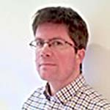
Evidence Pipeline
James Thomas

Slide 11

Current challenges
Finding relevant studies in a timely and reliable way.

Slide 12
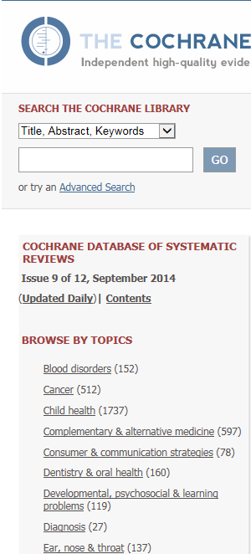



Cochrane Evidence Pipeline
CSS / CROWD
Completed reviews
RG specialist registers
Search strategies
Citation networks…
…?

Slide 13
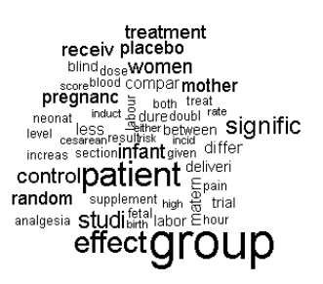
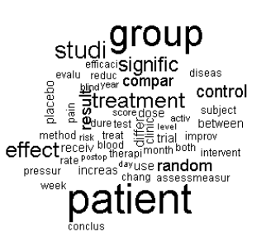
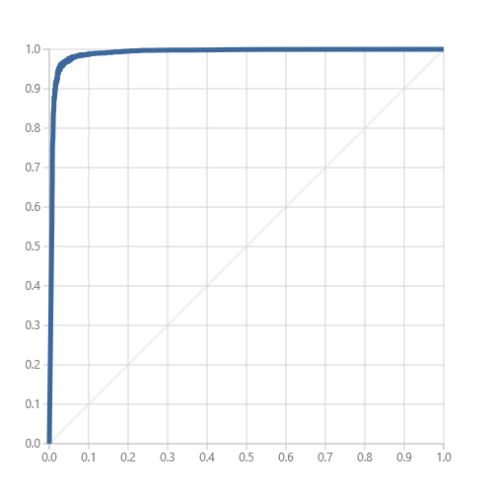
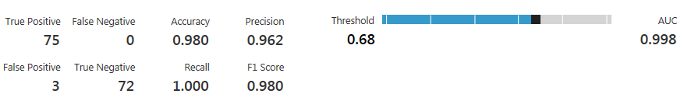
WILL IT WORK?
Randomly selected citations from Pregnancy & Childbirth Group compared with citations from other groups
Despite apparently very similar sets of most significant terms, the classifier performs well

Slide 14
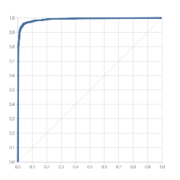
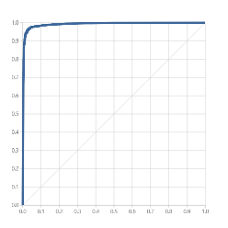
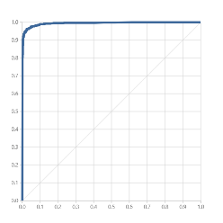
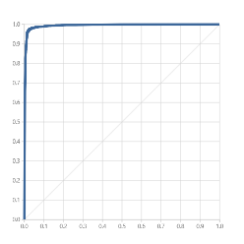
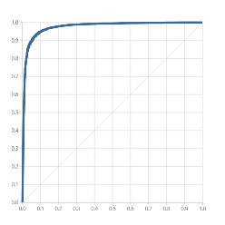
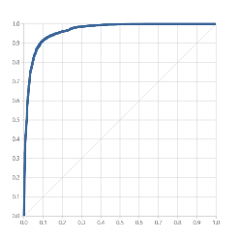
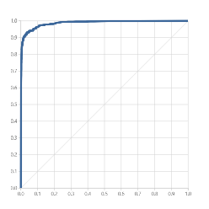
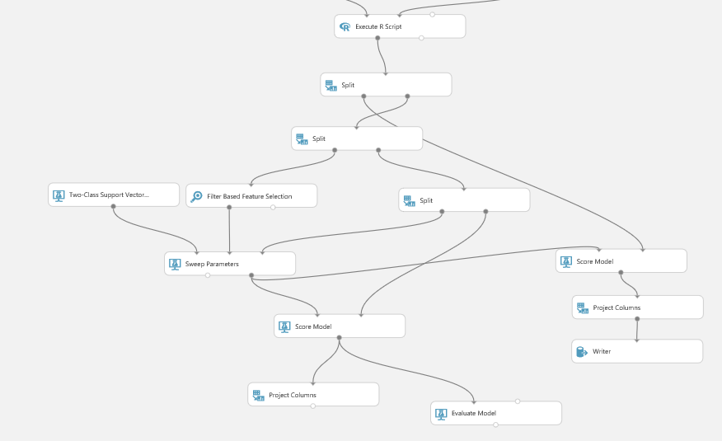
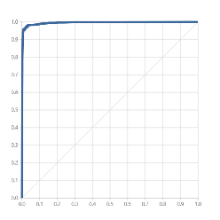
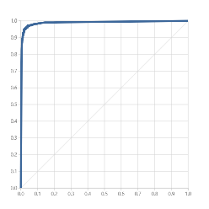
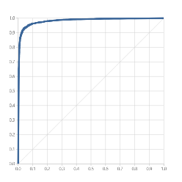
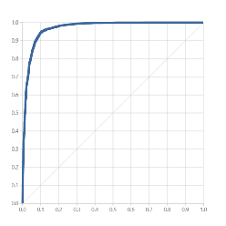
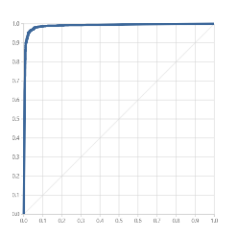
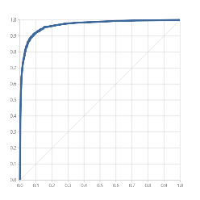
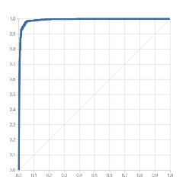
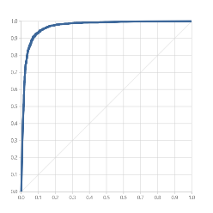
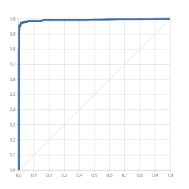
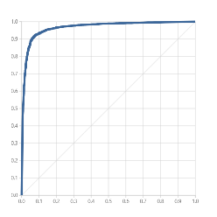

Evidence Pipeline
Using text mining and machine learning to identify the relevant Review Group for any new citation automatically.
Does it work? These ROC curves show that it can!

Slide 15
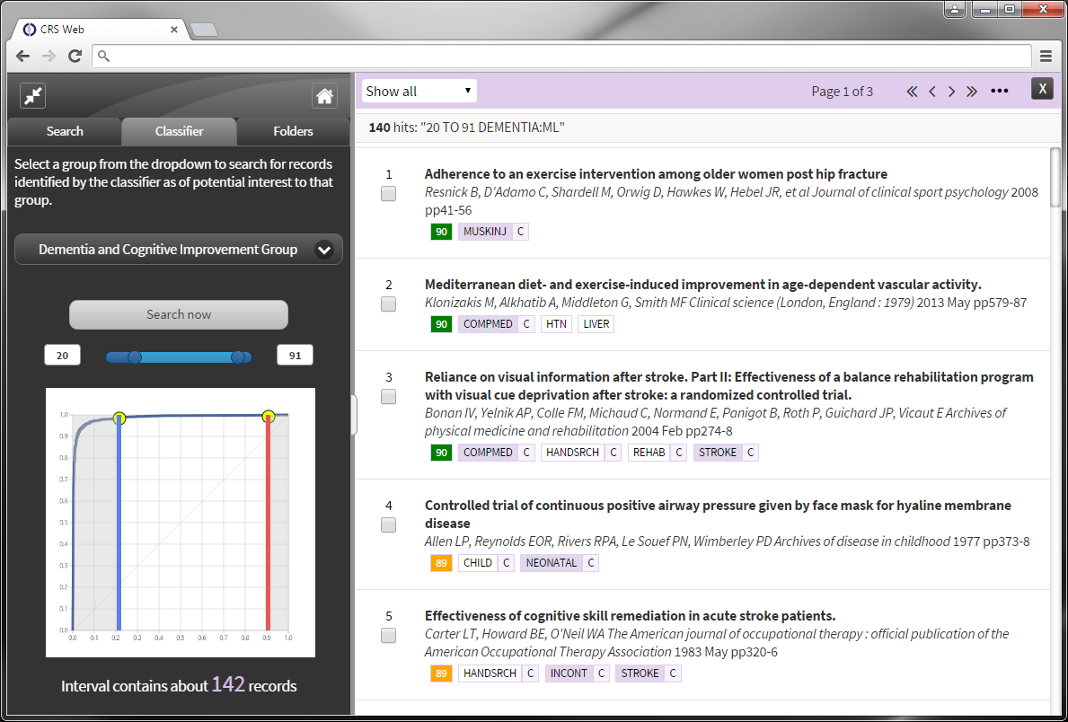
Within the new CRS-Web interface, you can:
Select the group that you’re interested in
Specify the range of scores you want to list
View the list of citations, ordered by their likely relevance

Slide 16
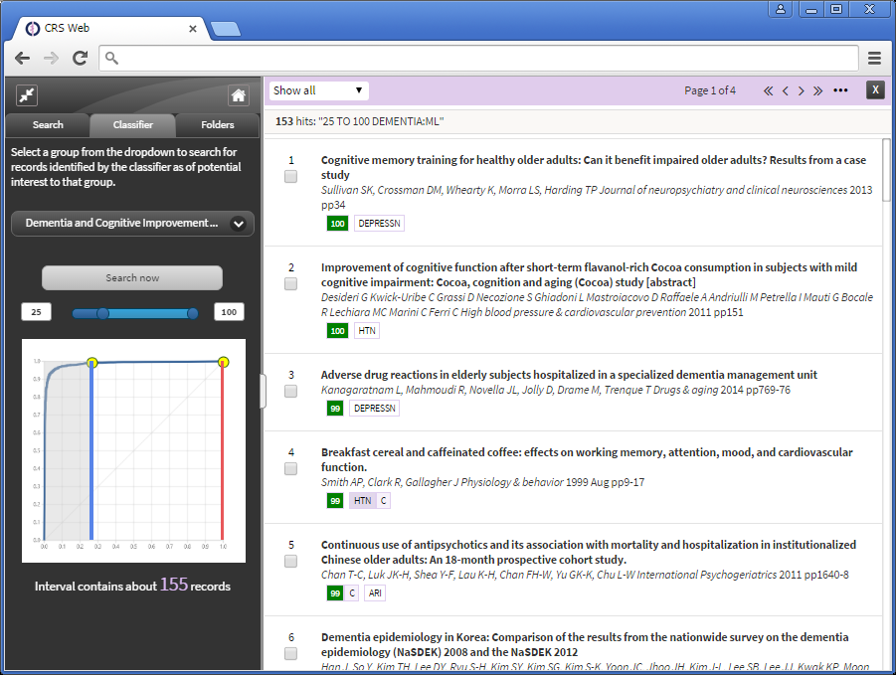

Slide 17
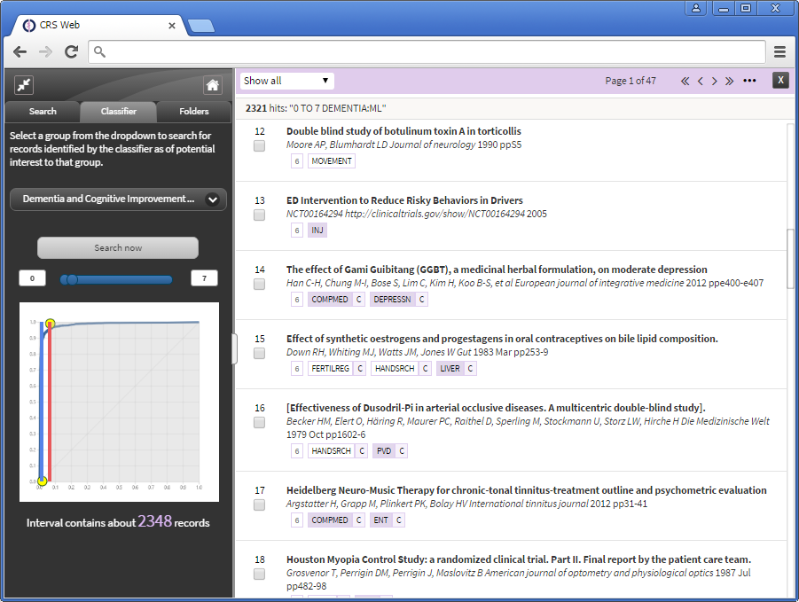

Slide 18
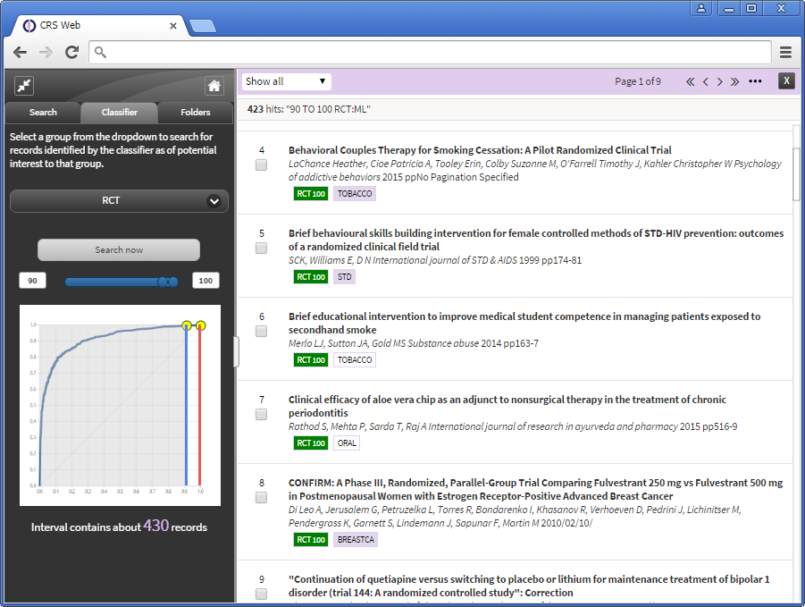

Slide 19
Summary
Citations ‘triaged’ to most relevant Review Group based on ‘signatures’ and ranked according to likely relevance
Links to Centralised Search Service and crowd sourcing component of Getting Involved
Ultimately hope to offer bespoke service to individuals with defined topic areas
See more at the Cochrane Exchange

Slide 20
Getting Involved: creating Cochrane citizen scientists
  Anna Noel-Storr
  anna.noel-storr@rdm.ox.ac.uk

Slide 21

Current challenges
Hello.
Can I come in?
We struggle to provide potential contributors with meaningful ways to get involved

Slide 22

Current challenges
Lack of choice

Slide 23



Current challenges
Currently the main route to contribution is as an author on a Cochrane review

Slide 24
Current challenges
“Global scientific output doubles every nine years”
[Nature News Blog, May 2014]
Information-overload

Slide 25
So wait a minute…
We have people who want to help
We have too much information/data to keep up

Slide 26

This is not new
Would this approach work for Cochrane?

Slide 27
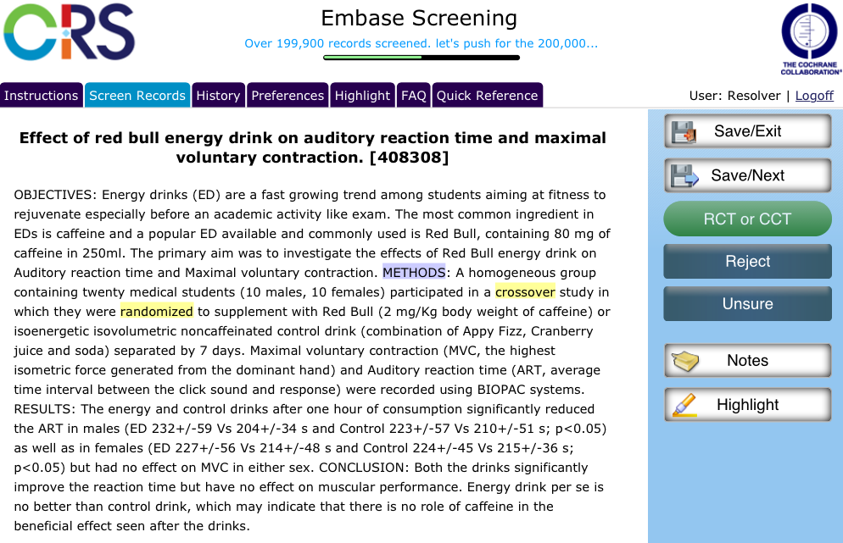
The Embase project
Help us find the trials!

Slide 28

The Embase project
A large batch of records identified from a very sensitive search for RCTs
“the distribution of small parts of a problem”

Slide 29
The Embase project
Since going live…
200,000+ citations
12,000+ RCTs
1600+ signed up

Slide 30

The Embase project
Feasible to recruit a ‘crowd’
High levels of accuracy
Why do people do it?

Slide 31
Appetite
“It feels good to be useful, because Cochrane is a prestigious organisation”
“Read 'Bad Pharma' and wanted to help!”
“To help out and to put something back into the profession”
“To help out! It's a great cause”
“We continually use Cochrane reviews but don't get involved in producing them so Embase screening is a small way to contribute”
“to do something useful”
“it seemed such a great thing to be able to help out every time I had a few minutes to spare”
I remain committed to evidence based practice and wanted to support it any way I could
“a desire to help the project. Crowdsourcing is cool”

Slide 32
Appetite
to help out a little and gain some skills”
“to maintain my skills”
“to help out with a really important project, but I am also learning at the same time. So it's really great”
“wanted to hone skills in identifying RCTs.”
To learn and develop skills
“To learn, practice and to make a tiny contribution!”
“Better understand
RCTs”
“To learn”
“to gain experience”

Slide 33
Appetite
to help out a little and gain some skills”
“to maintain my skills”
“to help out with a really important project, but I am also learning at the same time. So it's really great”
“wanted to hone skills in identifying RCTs.”
A stepping stone
“To learn, practice and to make a tiny contribution!”
“Better understand
RCTs”
“To learn”
“to gain experience”
Notes:
That’s an infrastructure problem – we don’t have the appropriate pathways in place to support the potentially vast numbers of people who would actually be prepared to contribute/would like to contribute. We’re missing an opportunity here.

Slide 34
Appetite
to help out a little and gain some skills”
“to maintain my skills”
“to help out with a really important project, but I am also learning at the same time. So it's really great”
“wanted to hone skills in identifying RCTs.”
“to help myself to be familiar with evidence based medicine, and prepare myself for possible future work with Cochrane”
“To learn, practice and to make a tiny contribution!”
“Better understand
RCTs”
“To learn”
“to gain experience”
Notes:
That’s an infrastructure problem – we don’t have the appropriate pathways in place to support the potentially vast numbers of people who would actually be prepared to contribute/would like to contribute. We’re missing an opportunity here.

Slide 35
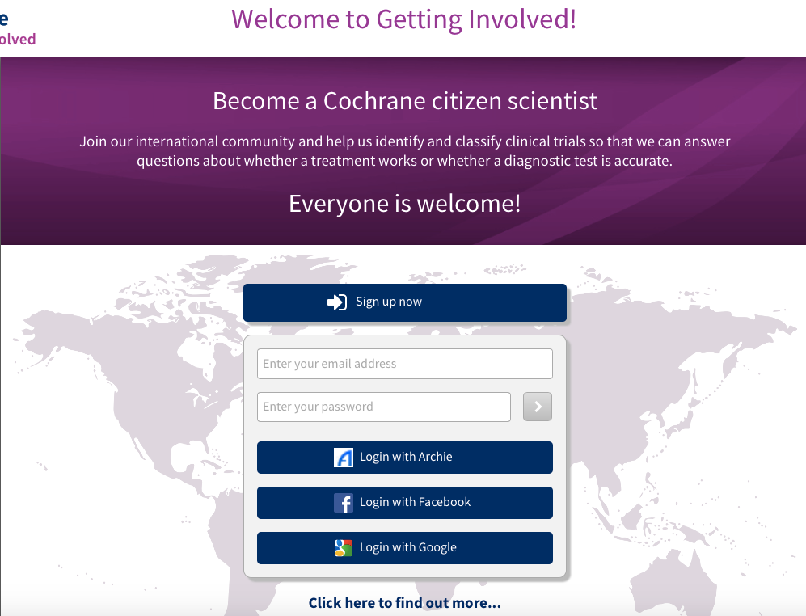


Slide 36
Getting Involved: more tasks
At citation level
RCT identification
DTA identification
RCT description

Slide 37
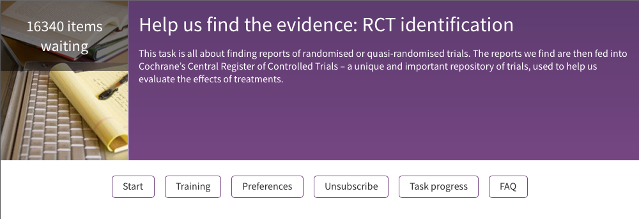
For each task:
For each task we’re developing interactive training

Slide 38
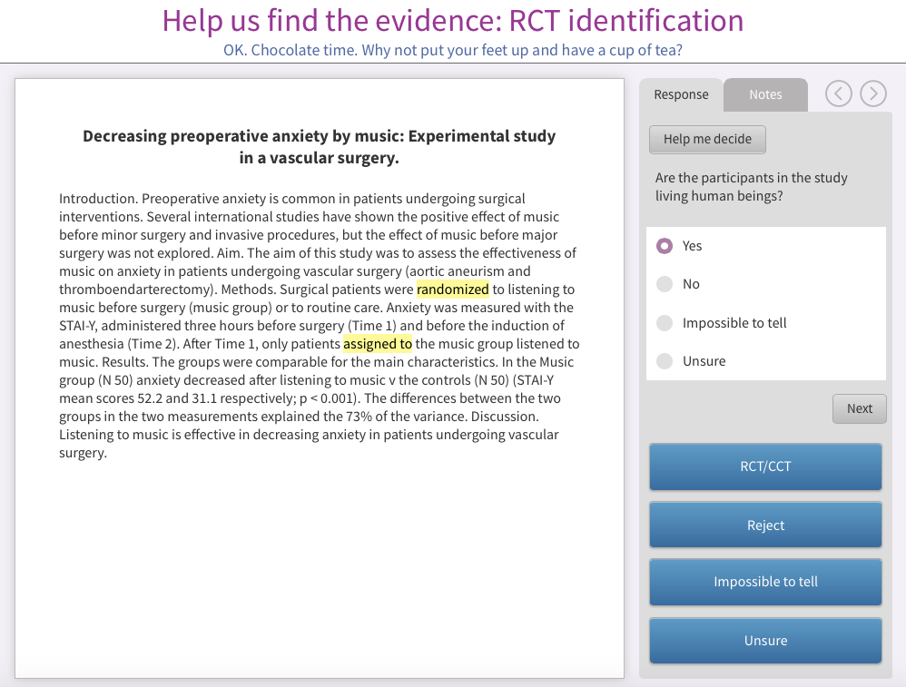
In RCT identification we have a Help me decide feature

Slide 39
For each task:
For each task contributors can set their preferences…

Slide 40

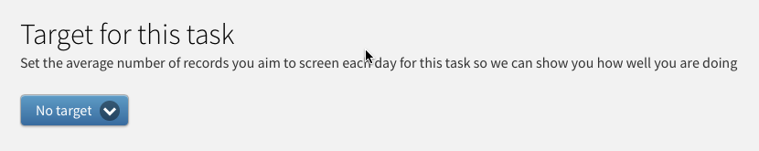
Preferences: offline working
Setting personal targets

Slide 41
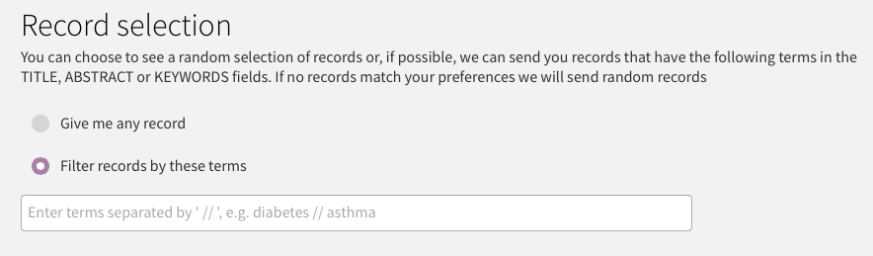
Preferences: filter by topic
People will want to classify records of potential interest to them

Slide 42
Summary
A model of contribution that brings benefits to contributor and to Cochrane
Taking all that we learnt so far and scaling-up
Complex, ambitious project not working in isolation (Centralised Search Service, Evidence Pipeline, Cochrane Membership, Linked Data)
Phase 1 = development
Phase 2 = pilot, refine, launch

Slide 43

Help to filter the information overload for better decisions!
Thank you
To find out more: Workshop Monday 4 October 11-12:20
anna.noel-storr@rdm.ox.ac.uk

Slide 44
Task Exchange

Slide 45
Aim
To connect members of the Cochrane Community
who want help with their reviews with people
who have the skills and time to help.

Slide 46
taskexchange.cochrane.org
“Airtasker for Cochranites” (but we reckon it’s prettier…)

Slide 47


Slide 48
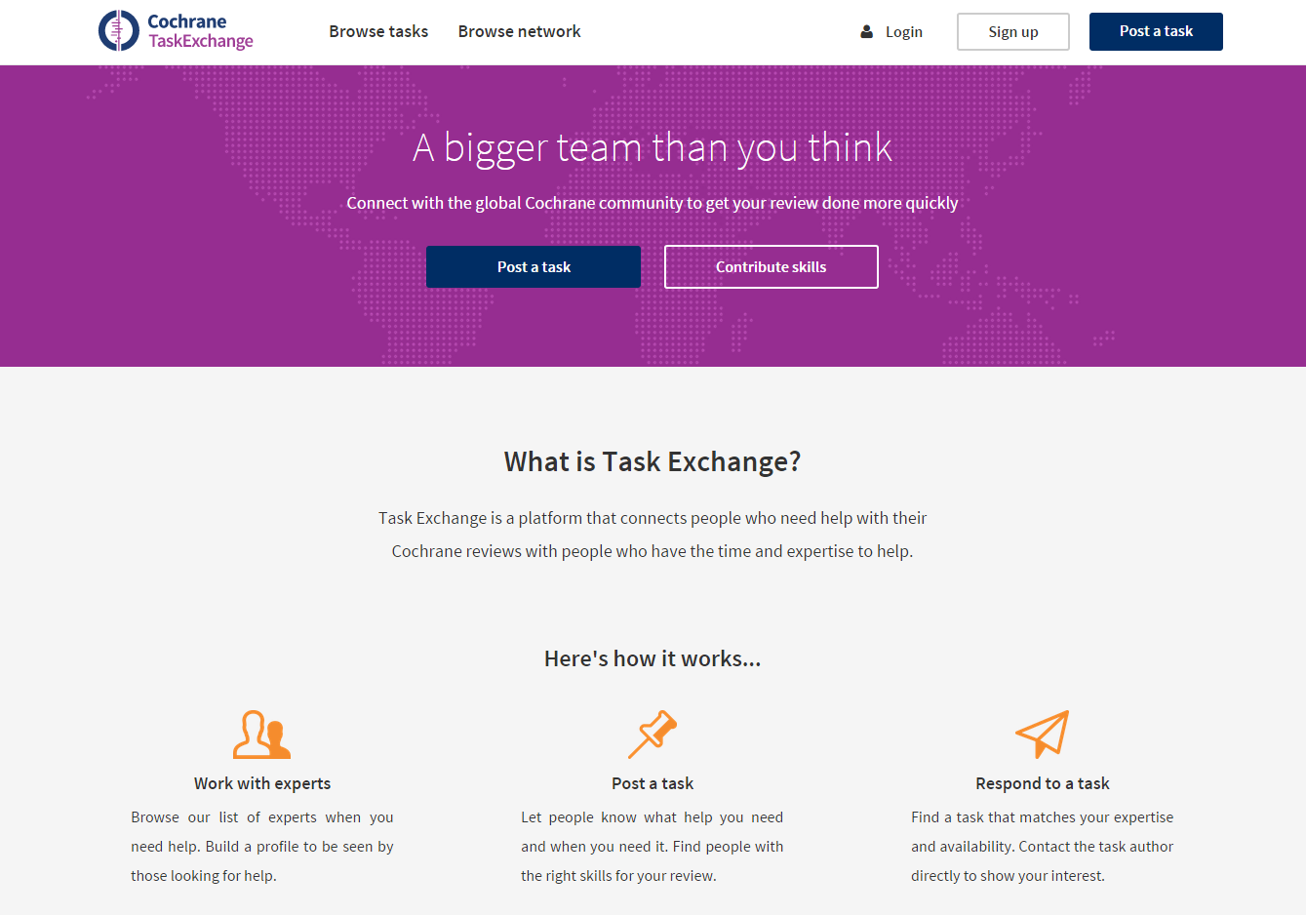

Slide 49
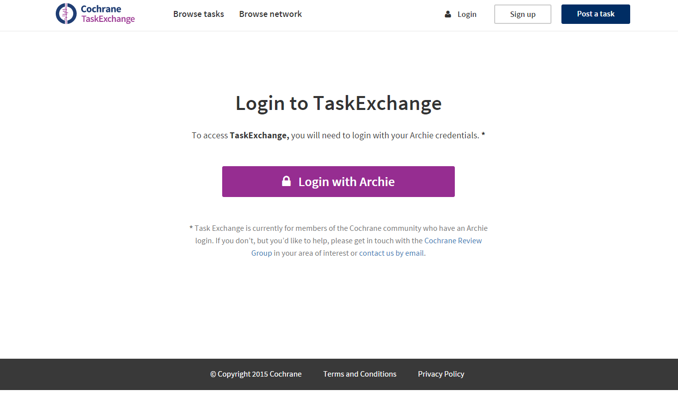

Slide 51
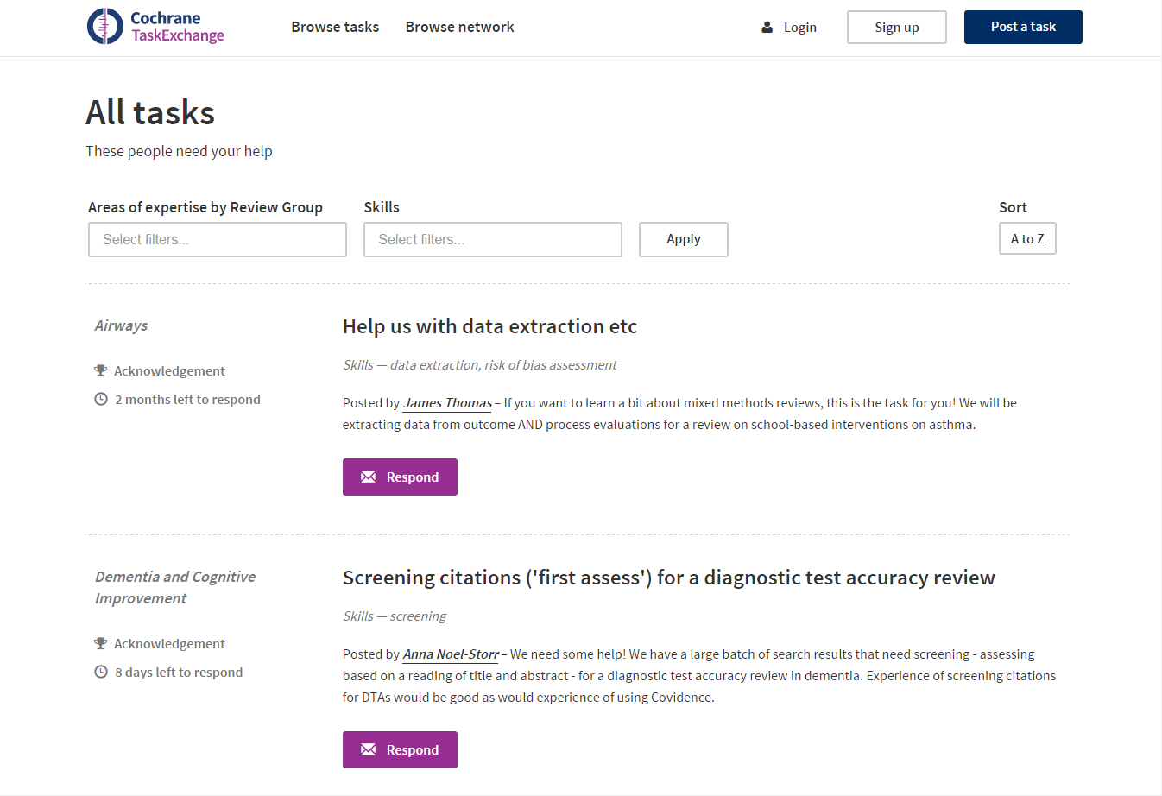

Slide 52
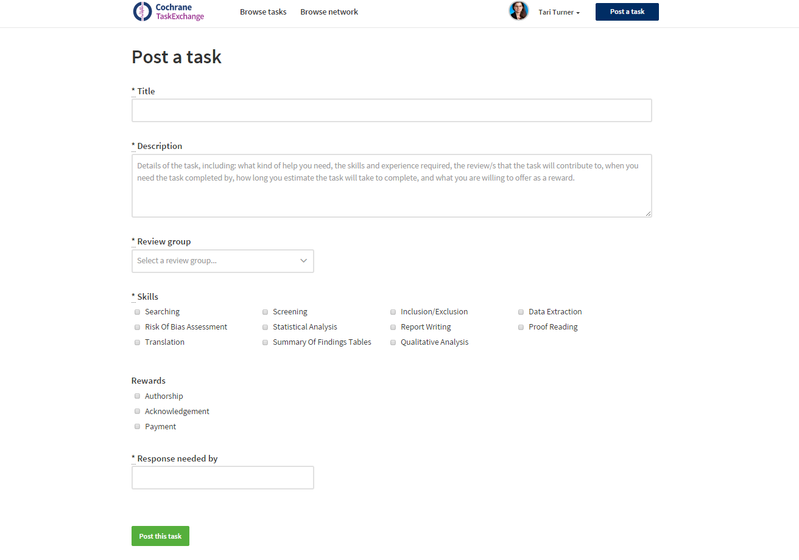

Slide 54
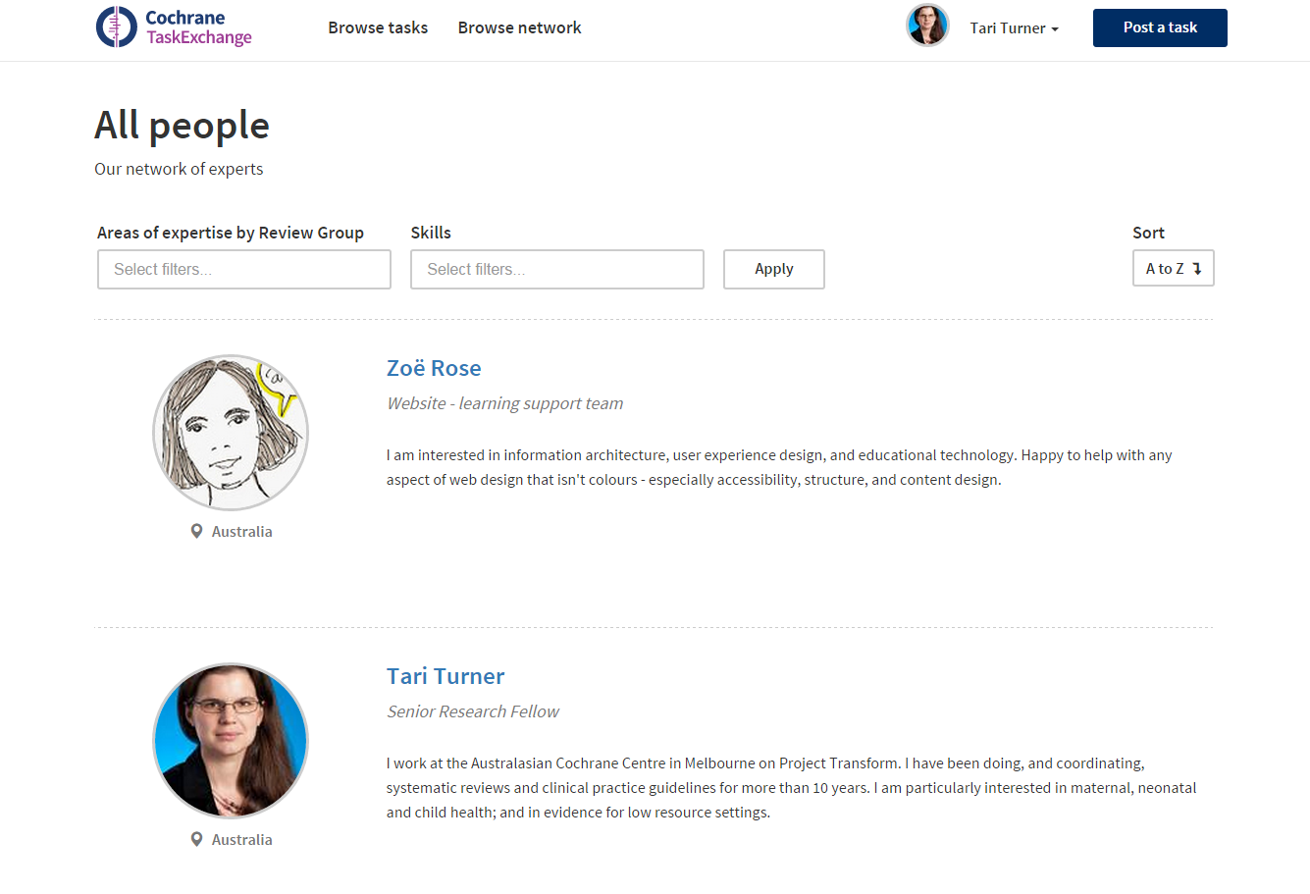

Slide 55
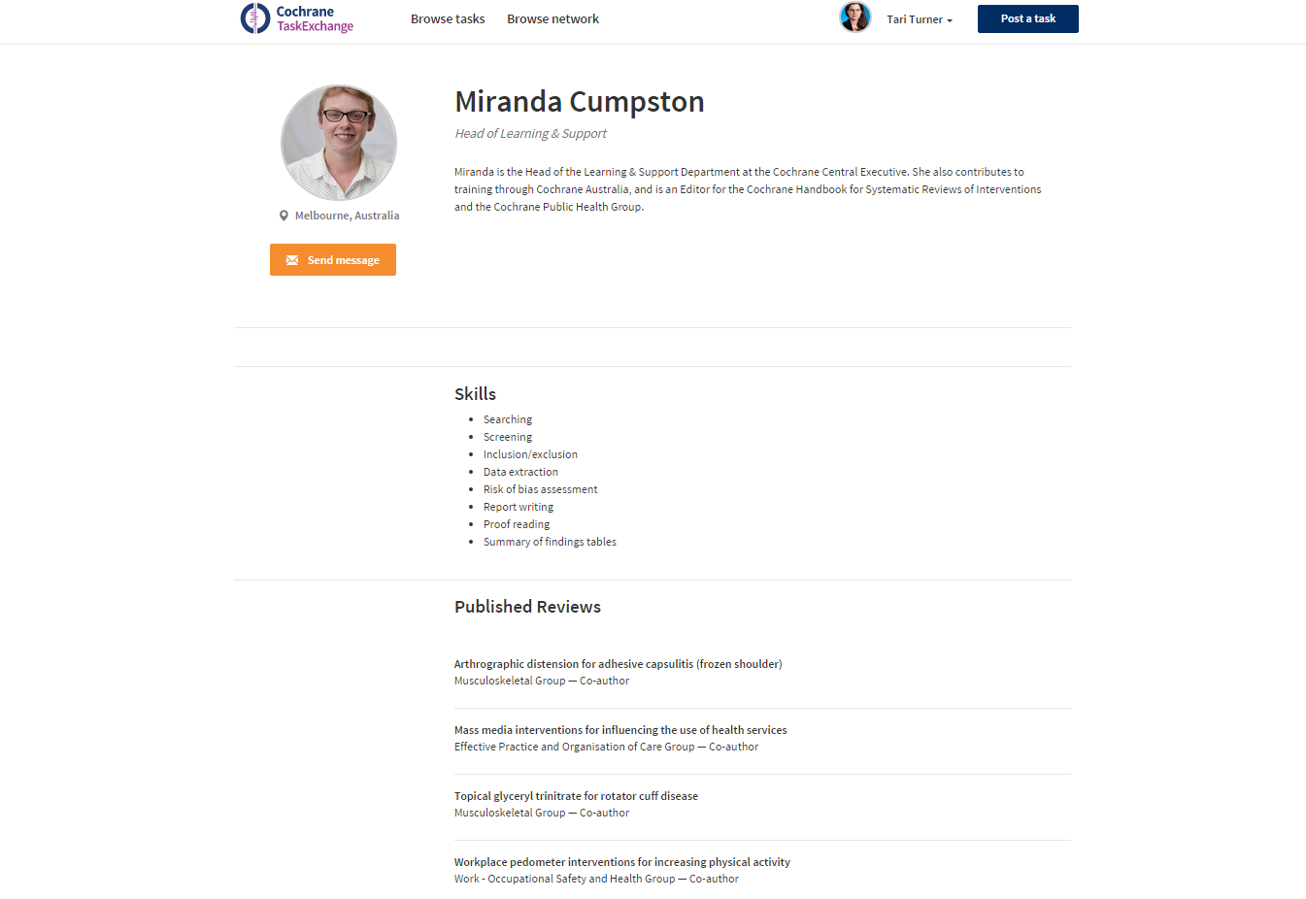

Slide 57
Next steps
For the developers:
  Second round of development
  October – December 2015
  Beta release
  February 2016
For Cochranites:
  Sign up, load your profile, post and respond to tasks
  Today!
  Give us feedback
  At the workshop tomorrow or by email any time: taskexchange@cochrane.org

Slide 58
taskexchange.cochrane.org
A bigger team than you think

Slide 59
Production Models
Early findings from our exploration of current approaches to systematic review production

Slide 60
Background
Production Models is one of the 4 components of Project Transform
Aim is to identify, pilot and scale up new ways of producing Cochrane reviews that increase quality and timeliness.
Led by Tari Turner (Australasian Cochrane Centre), under the guidance of David Tovey and Julian Elliott
Started in July 2015

Slide 61
Voices
24 interviews
      MEs (6), Authors (6), External (5), CRG staff (3), CoEds (2), Editors (2)
90 online surveys
      Authors (37), MEs or CoEds (17), TSC (12), Consumers (11), Methodologist (10), Editors (4), Centre Staff (3), CEU staff (2), Other (8)
  Informal ‘rough-cut’ analysis

Slide 62
The unsurprising part
Wide variety of approaches to review production between and within Review Groups
It’s all about people
Every review is unique & unpredictable
“that’s the ‘collaboration’ bit of The Cochrane Collaboration... it’s all about the human relationships”
“good people drive good processes”
“treating review production like a factory is a mistake”

Slide 63
How are we producing reviews?... In every way imaginable!
Emerging themes around:
  Author team requirements, structure and incentives
  Roles of Review Groups
  Shared challenges
  Approaches to improving the production process

Slide 64
Author Teams
  Team formation & task allocation are largely informal and organic
Payment models vary
    Fully paid teams, Outsourcing, Teams with paid members, Incentives & stipends, Fully volunteer teams
    Having money helps, greater accountability, but doesn’t solve all problems
Requirements vary, but agree importance of an effective leader
    Tension between focus on capacity building and benefits of experienced authors
    Challenge of sourcing timely clinical input & not wasting this time on tedium
“Some people just get on and do it, and you can’t predict who will”
“Things move along in a different way where there is a little funding for the review team to justify spending the time”

Slide 65
Roles of Review Groups
Extent of project management varies widely
    Active, hands-on management by a range of people
    Hands-off
    Sense of trend towards more hands-on management
Variation in how CRGs see their role as & have challenges with providing clinical input,
methodological guidance, editorial oversight
Substantial issues with peer review processes
“If you can find a Review Group where people are less hands-on than we are and are producing good reviews,
I’d like to see it”

Slide 66
Shared challenges
Conflation of review production (“the science”)
and editorial processes (“the publication”)
Increasing complexity of methods
Difficulty keeping authors on board and on track
The length of the process
  They are interrelated - no easy answers

Slide 67
Approaches to improvement
  Breaking reviews into chunks
  Standardising review content
  Truncated protocol processes
  Suites of reviews
  Increased specificity of searches
  Focusing on simple, reliable, useful reviews
  “Very important to move on from thinking that everybody has to do every part of the review”
  “Go back to basics… Stop expecting complexity in all reviews”

Slide 68
Approaches to improvement
Starting on the right foot
      Tightening title registration
      Extended protocol processes
      Author team requirements
Widespread appetite for automation and software support
“Make the routine part more automated so we can focus on the fun – remove the drudgery”

Slide 69
Next steps
→ Finalise data collection: November 2015
→ Complete analysis and report: February 2016
→ Identify/develop models to pilot: Feb – August 2016
→ Begin piloting: September 2016
“the more I work with Cochrane the more I think they’ve got it right”

Slide 70
If you’d like to find out more
Email me (tari.turner@monash.edu) or stop me in a corridor and offer to buy me a coffee ;-)

