Slide 1
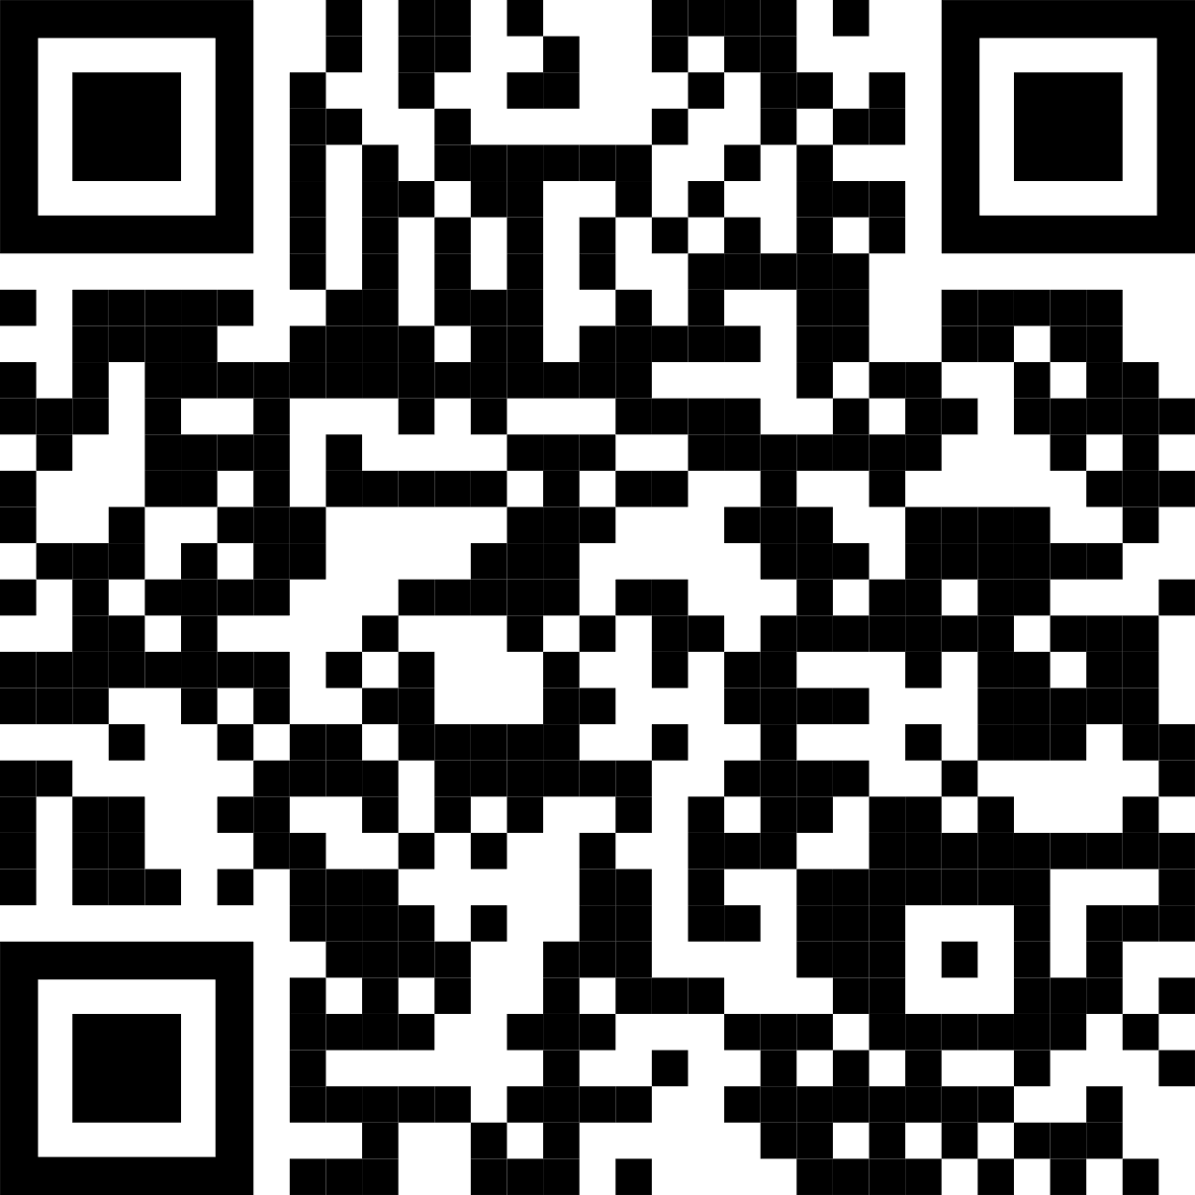

Main finding goes here, translated into plain English. Emphasize the important words.
The Problem
EXTRA STUFF
Delete this and replace it with your…
Extra Graphs
Extra Correlation tables
Extra Figures
Extra nuance that you’re worried about leaving out.
Keep it messy! This section is just for you.
Just give context for the gap you’re filling with your research.
Methods
Key Results
N = ###,
Collected this
Tested with X statistical test
Check out #VisualAbstract on Twitter for examples.
Graph or table with essential results only.
All the other correlations in the ammo bar.
Check out Stephanie Evergreen’s blog on how to create quickly-understandable figures.
Title goes down here, because your main finding sentence makes it redundant.
You can delete the Cochrane logo and add your group’s logo in it’s place. Have multiple logos? Just stack them above
SAMPLE
Leeroy Jenkins, author2, author3, author4
Take a picture to get the full paper.

Slide 2



How to create a QR Code
How do I create a QR code?
https://www.qrcode-monkey.com/ is free, URLs don’t expire, and you can add cool features like images.
How do I scan a QR code?
Just pull out your phone and take a picture! All modern iPhones and most Android phones have built-in QR detection in their cameras. Some Android phones may need an app. https://twitter.com/kristinrojasmd/status/1124418213050298368
How can I link the QR to my paper and a copy of my poster and my contact details.
Try creating a multi-page link for free via https://linktr.ee/. (Still trying to figure out the best answer to this though.
Ctrl-click this thumbnail to watch a video on scanning #betterposter QR codes.

Slide 3


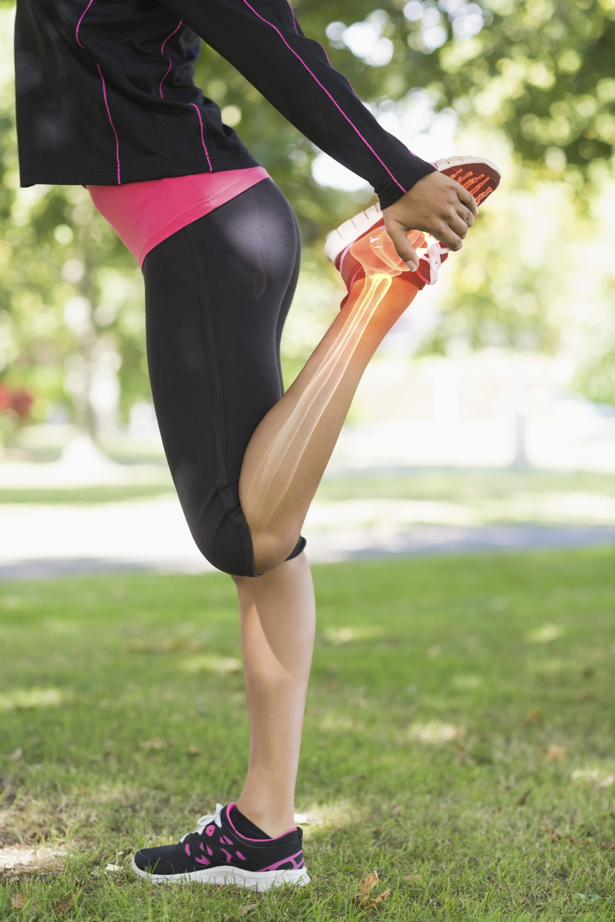


Add Images
Prime & reinforce the topic of your study with accent imagery.
Cochrane branded images should follow the Cochrane brand guidelines. We suggest:
All images should illustrate our strapline: ‘Trusted evidence. Informed decisions. Better health’.
Choose light and bright imagery that works in harmony with your group’s colour palette.
Select positive, simple, and close-up images.
Please see the Community brand resources for our Brand Guidelines and information on how to get access to our Cochrane photos dropbox, and request purchasing of pictures.’

Slide 4
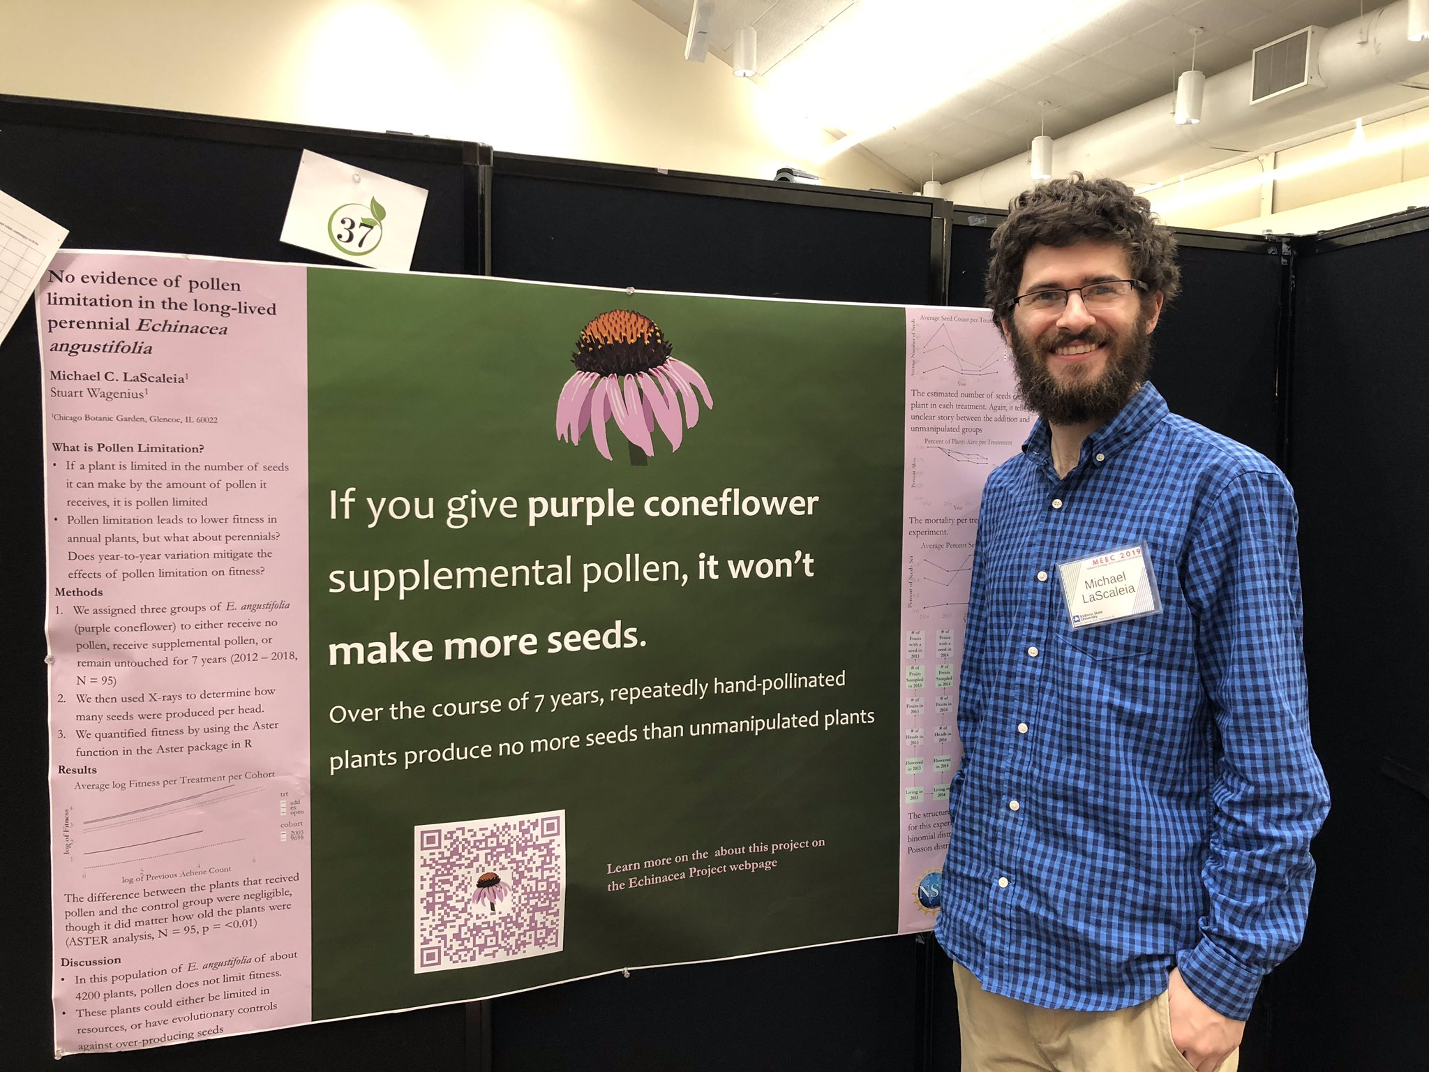
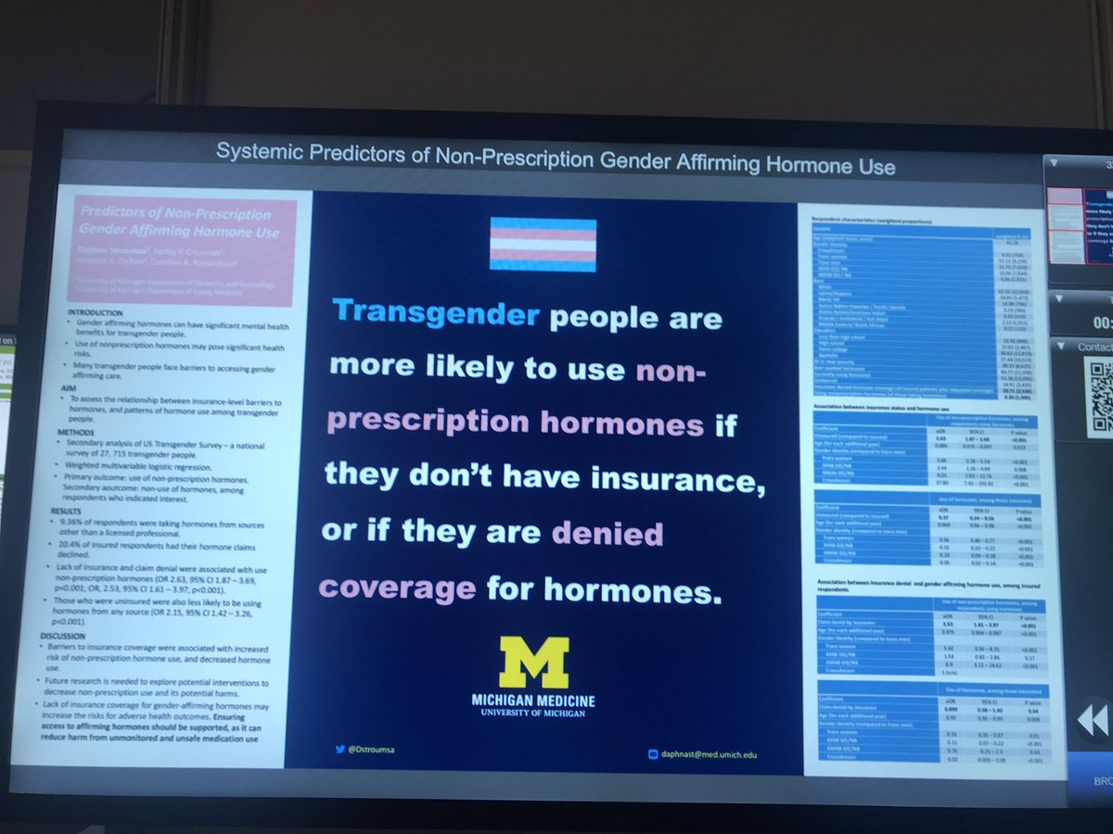


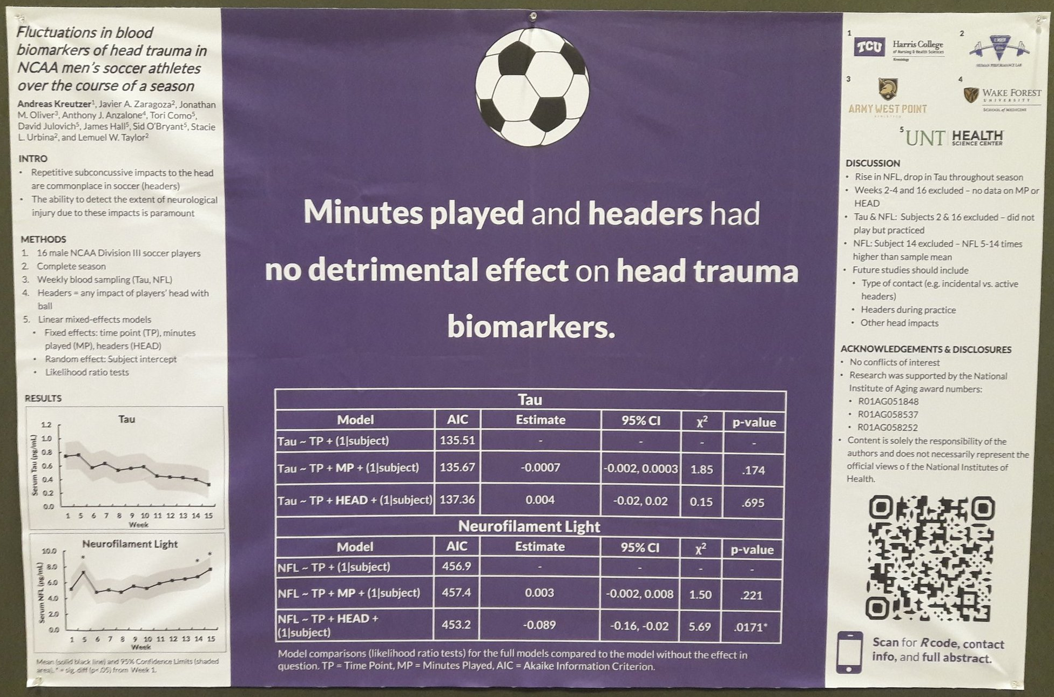
A simple icon.
Fun, reinforces your finding, makes your poster memorable
— and can be interpreted at-a-glance.
Example donated by @MCLaScience
Example donated by @DStroumsa
Example donated by @ElzaRechtman
Example donated by @mikemorrison
Example donated by @akreutzer82

Slide 5
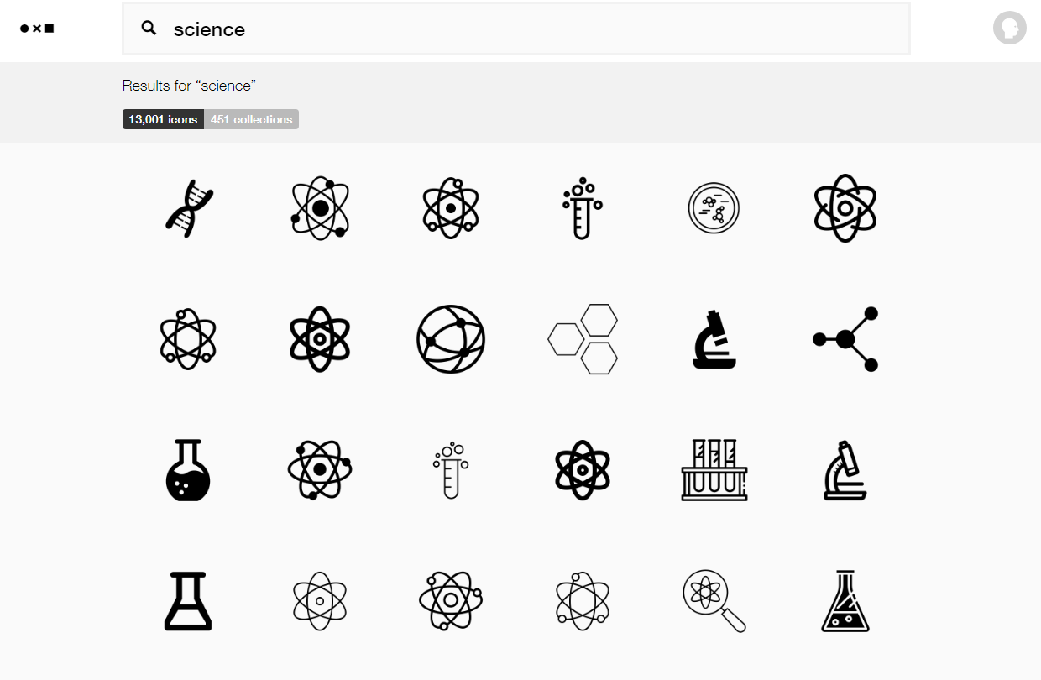
You can get icons from
TheNounProject.com
https://thenounproject.com

Slide 6

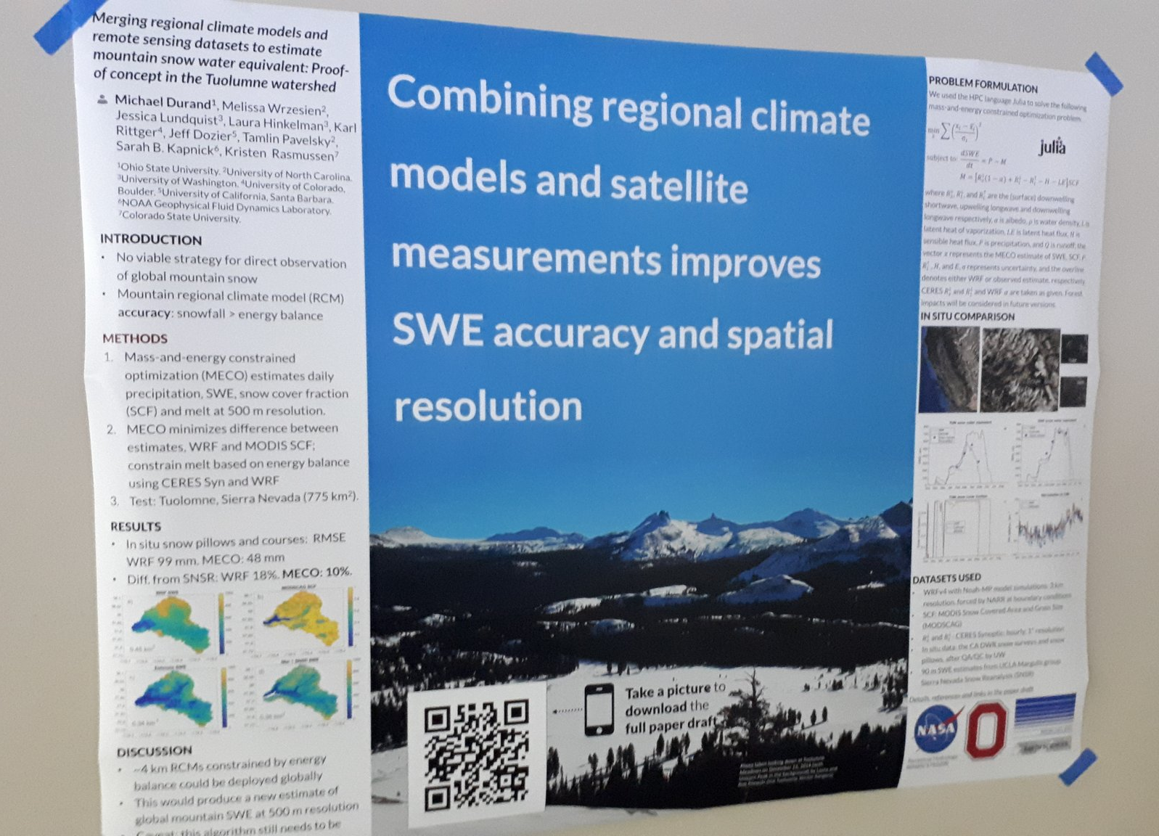

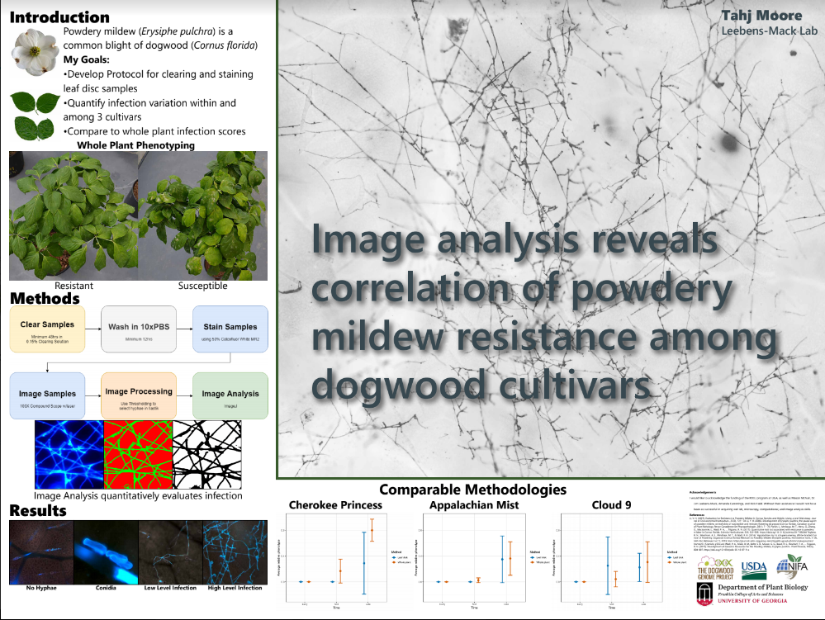

The on-theme background.
Add fun and reinforce your study’s context.
Tip :Keep a high contrast between your text and background!
Example donated by @brenden0walker
Example donated by @hydrogawker
Mountain photo by @mnthydro
Example by @mikemorrison
Example donated by @SarraceniaMason
Example donated by @americoamorim

Slide 7
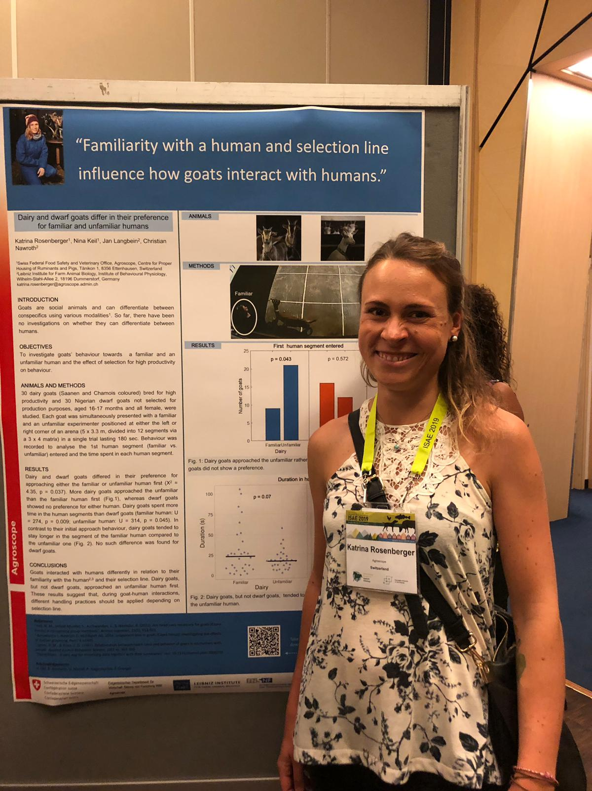
More Examples
Example donated by Katrina Rosenberger

Slide 8
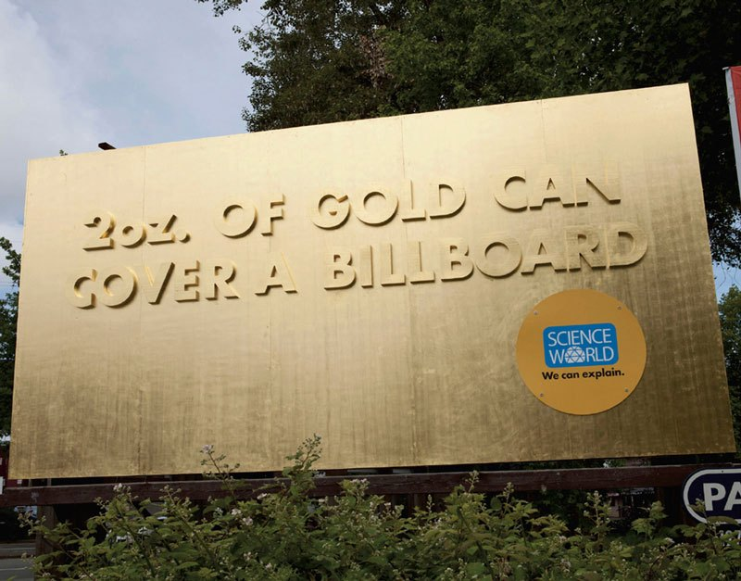


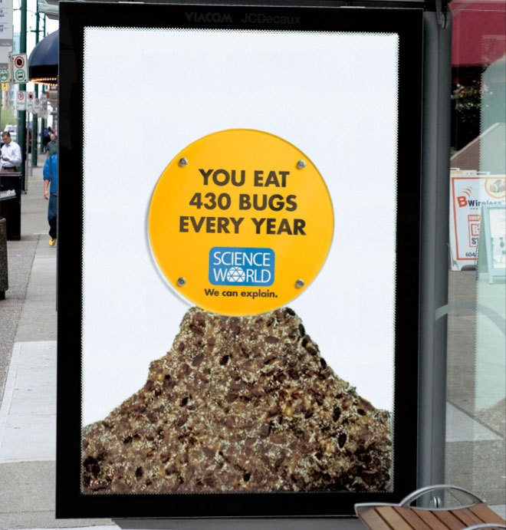
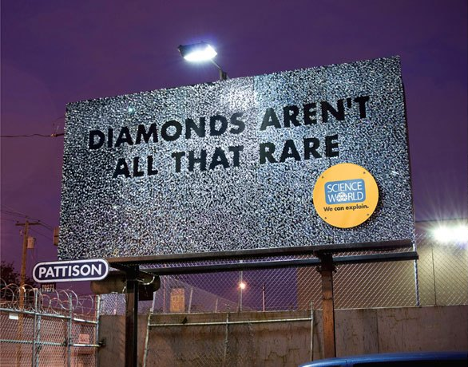
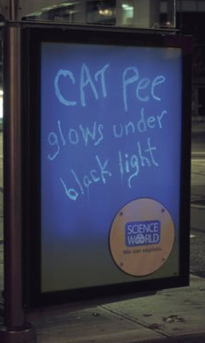
Memorable science billboards for inspiration.
Ctrl+Click here for more.

Slide 9
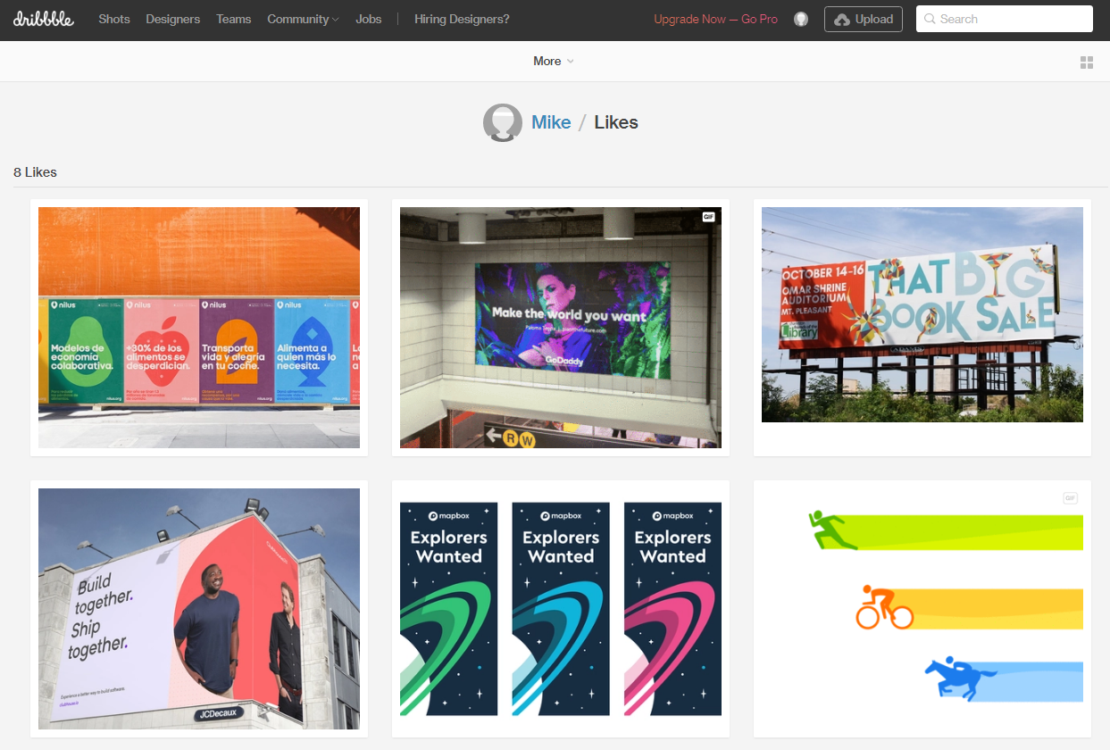
Stuck on a design dilemma? Do what other designers do! Go to dribbble.com and scroll through stuff until a solution jumps out at you. Try searching “posters” or “graph”.
https://dribbble.com/

