Slide 1
Delivering Strategy to 2020 in 2016: what’s ahead?
UK & Ireland Symposium, March 2016
Mark Wilson, CEO
Trusted evidence.
Informed decisions.
Better health.

Slide 2
Strategy to 2020 aims to put Cochrane evidence at the heart of health decision-making all over the world.
It belongs to all of us in this room, and to the contributors around the world.

Slide 3
Our Strategy to 2020 has 4 Goals
Goal 1: Producing evidence To produce high quality, relevant, up-to-date systematic reviews and other synthesized research evidence to inform health decision-making.
Goal 2: Accessible evidence To make Cochrane evidence accessible and useful to everybody, everywhere in the world.
Goal 3: Advocating for evidence To make Cochrane the ‘home of evidence’ to inform health decision-making, build greater recognition of our work, and become the leading advocate for evidence-informed health care.
Goal 4: Building an effective and sustainable organization To be a diverse, inclusive and transparent international organization that effectively harnesses the enthusiasm and skills of our contributors, is guided by our principles, governed accountably, managed efficiently, and makes optimal use of its resources.

Slide 4
Notes:
On the fabulous new Community site, you can view and download this year’s Strategy to 2020 targets…

Slide 5
2015 - a year of huge achievement
Find many of the details on the Cochrane 2015 Dashboard … but some of the external-facing highlights

Slide 7
A new brand and website in multiple languages + 140 Group websites
30% increase in website visits since launch
cochrane.org

Slide 8
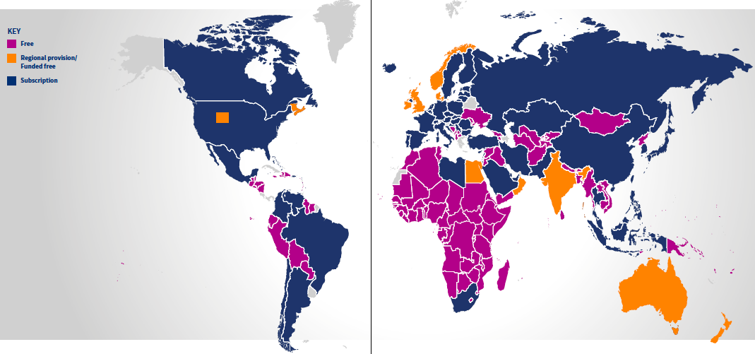
Goal Two: Making our Evidence Accessible
To make Cochrane evidence accessible and useful to everybody, everywhere in the world.
3.66 billion people in 148 countries already have free at point of use access
New Open Access Strategy completed and approved. By end of 2015: 31% of ‘current’ Reviews available (through Green & Gold OA)
CSG confirmed the goal of all Cochrane Reviews available OA by the end of Strategy 2020
And now, from early 2016:
All Cochrane Protocols available OA in the Library
All Cochrane Reviews automatically deposited in PubMed Central 12 months after publication
To explore provision of limited number of ‘Gold’ OA licences for major funders
Notes:
Major user research project underway
Linked data annotation of reviews and studies by end of 2016
New ‘Knowledge Translation Strategy’ for Cochrane evidence in 2016
Translation strategy approved March 2014, including major investment in Translation Management System support software
Expansion of number and output of translation teams; and pilot new models of ensuring sustainable translations in 2016
Full Cochrane.org website available in first five languages by end of 2015
Cochrane Evidence now available in 12 languages on Cochrane.org
Cochrane Library available in first five languages by mid-2017 at the latest; including integration of the Spanish language Biblioteca Plus
CSG decided from early 2016:
a. All Cochrane Protocols will be available Open Access via the Cochrane Library.
b. All Cochrane Reviews will be automatically deposited in PubMed Central 12 months after publication
c. We will explore the provision of a limited number of vouchers for discounted ‘Gold’ Open Access to Cochrane’s funding agencies; which means that funders can get immediate Open Access for a selected number of Reviews at a discounted rate.

Slide 9
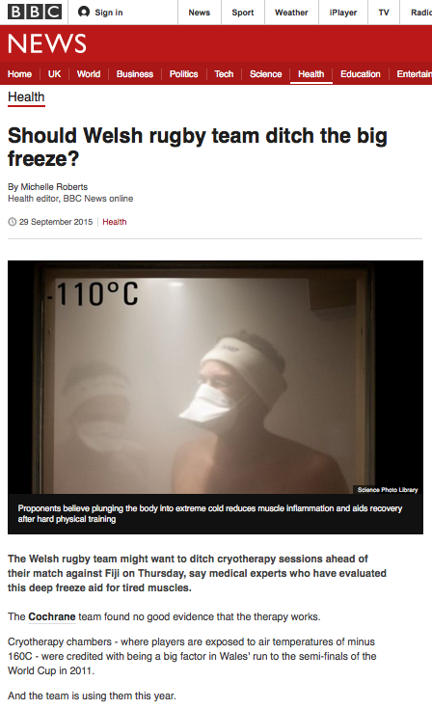
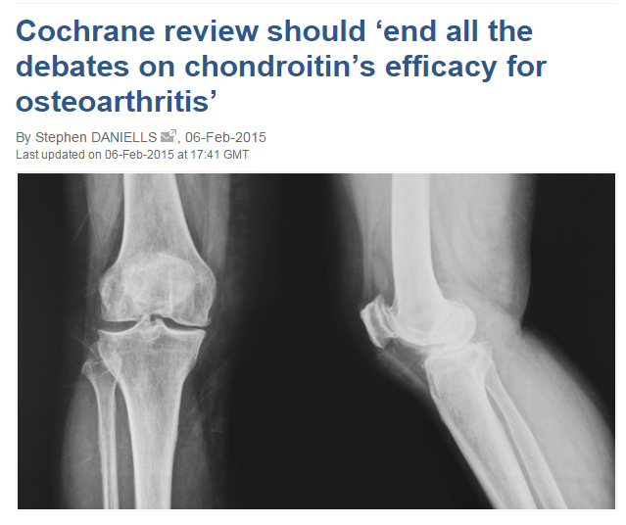
Cochrane Reviews making an impact in the media
22% increase in media coverage
evidentlycochrane.net/portion-size, Cochrane UK

Slide 10
Cochrane Reviews making and impact on guidelines
magic.piktochart.com/output/6769004-who-guidelines-infographic

Slide 11
Key partnerships
World Health
Organization
GRADE
Working Group

Slide 12
Derivative products & services through Cochrane Innovations
cochraneclinicalanswers.com

Slide 13
In 2016…
Strategy to 2020 enters its third year.
Ongoing projects focussing on technology improvement, business structures and processes, and membership will be delivered.
Delivery of these projects will impact users, but also Groups and contributors.

Slide 14
17 targets for 2016
… and how you can help us achieve them

Slide 15
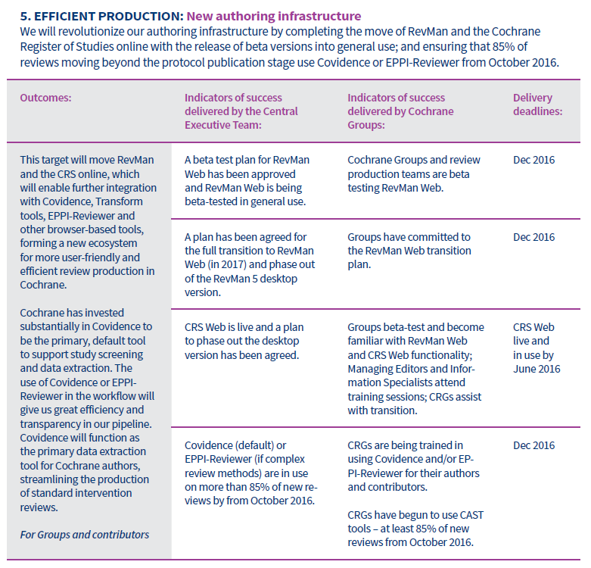
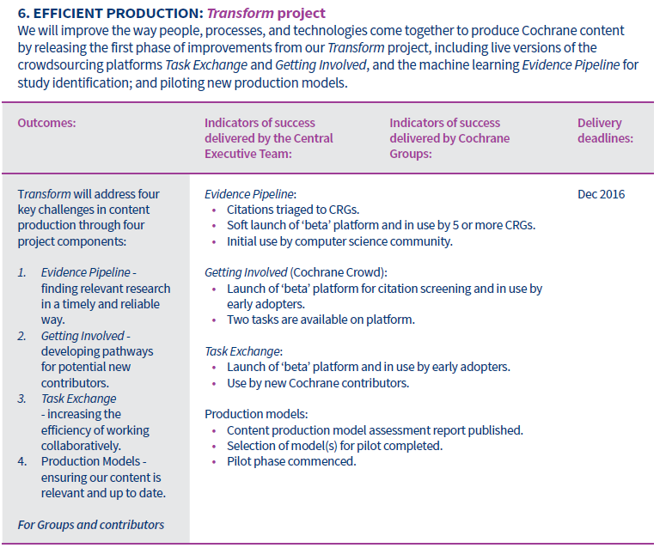

Slide 18
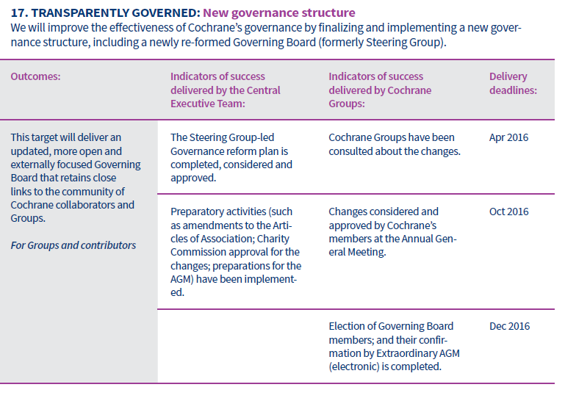
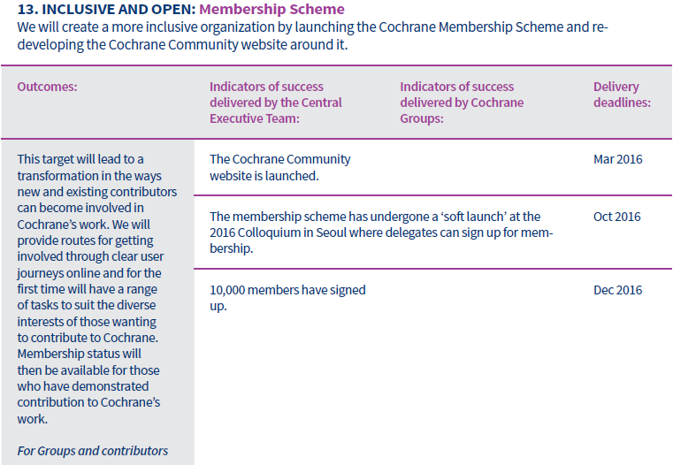

Slide 19
A Question and Answer session with representatives of the Senior Management Team

